Slide 1
Welcome to Space Program Management (PM 101)
“So now that I’m here what do I do?”
1) Get a Name Tent
2) Write your Name & Organization
(e.g. Joe/LEE, Mary/MCE, etc. )

Slide 2



Space and Missile Systems Center (SMC)
Space
Program Management
101
Introductions

Slide 3

Your Instructor
Joe Boyle
COLONEL USAF (RETIRED)
28 Years of PM experience in uniform
10 years of PM experience consulting
Expertise:
Research & Development (AFRL, Propulsion)
Test and Evaluation (Flight Test Center, B-2, F-22)
Program Element Monitor (Rocket Propulsion)
Foreign Exchange (NATO & Germany)
Program Manager (LTRS: I&M, RSA ; EELV; Deputy PM, Launch Wing Chief Engineer)
Consultant with:
Monitor Group LLP
Dayton Aerospace Inc.
X-Prize Foundation
University of Tennessee - National Defense Business Institute
Affine LLC
Boyle Enterprises
PM: Program Manager AFRL: Air Force Research lab NATO: North Atlantic Treaty Organization LTRS: Launch and Test Range System
I&M: Improvement & Modernization RSA: Range Standardization and Modernization EELV: Evolved Expendable Launch Vehicle
LLP: Limited Liability Partnership LLC: Limited Liability Corporation USAF: United States Air Force

Slide 4

Course Materials
Participant Exercise Book (11th Edition)
CD/DVD (Compact Disk/Digital Video Disk)
Slides (all slides, some not presented)
Templates
Source material
Flip charts
Computers (personal laptops)
Let’s Get With The Program!
Participant Exercise Book
Space and Missile Systems Center (SMC) University
11th Edition

Slide 5
Introduce Your Classmates
Pair off (groups of 2)!
Interview your partner (2-3 mins each, 6 mins total) (see workbook page 3)
Introduce your partner to the class (1 minute), tell the class the following:
Name
Home Town
School(s) attended/degree(s)
Position here at the Space and Missile Systems Center (SMC)
Three things they do in that position
Is it a Program Management (PM) position
Why are they taking this course
What is their number one expectation of this course
One thing most people that know them don’t know about them!
Who was on schedule?
Who met performance?
Was there a cost?

Slide 6
MODULE 0NE
Course Introduction/Overview

Slide 7
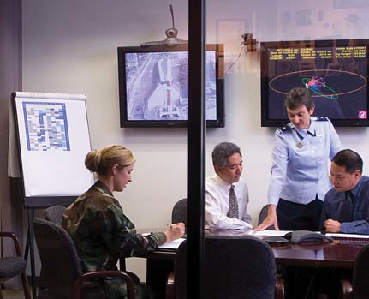
Program Management Course Concepts
The purpose of this course is:
Discuss the role of an SMC Program Manager (PM)
(aka: system Program Director – SPD)
The uniqueness of working in space
Your role in this endeavor.
“what I actually do, and how it effects the PM”
Notes:
The purpose of this course is to communicate to you the work of a program manager at SMC and the nuances of working in space.
Convey how SMC builds, launches and operates space systems…this is the Center’s story and your role in it….

Slide 8

Program Management Course Objectives
Learning Objectives:
Define the Role of Program Management
Comprehend the Program Manager’s Acquisition Challenges
Explain the Characteristics of an SMC Program

Slide 9
Program Management Course Objectives
Learning Objectives (cont.):
Discuss the Interdisciplinary Nature of Program Management
Identify Defense Acquisition Program Lifecycles and Associated Program Management Activities and Where SMC is Unique

Slide 10
Program Management Course Focus
We will explore:
The interdisciplinary nature of program management
Main functional areas
Engineering
Financial Management
Contracting
Acquisition Logistics
Discuss how the functions interplay in program success
The acquisition lifecycle from cradle to grave
The concept of risk and risk management
Basic definitions and terms (define all acronyms)
The Uniqueness of Space Acquisition
Notes:
Discuss the interdisciplinary nature of program management:
Functional areas of responsibility and the Program Manager’s accountability
Networking and integration of efforts
The acquisition lifecycle from requirements development, to engineering, to contracting to financing to total cost of ownership
The concept of RISK and how to manage it to control Cost, Schedule and Performance
Contrasts between the event-driven, life-cycle acquisition and calendar-driven execution

Slide 11

Program Management Course Design
The curriculum is divided into modules that emphasize:
Program Management
Triple Constraint
Risk Management
Program Phasing
Functional Disciplines
Financial Management
Engineering Management
Acquisition Logistics
Contracting
Industry’s Role
Technical Reviews
Source Selection*
* Summarized but not addressed in detail, Space and Missile Systems Center University (SMCU) has a separate course for “Technical Evaluations”
Notes:
This course begins with an acquisition overview, a focus on the basics of program management , followed by the PM’s challenges, the variety of disciplines the PM interacts with and finally how some of these play out differently across a program’s life cycle.

Slide 12
Program Management Course Design
We’ll use Different Kinds of Learning Experiences & Applications
Including:
Activities
Interactive Events
Exercises
A Capstone Event
Notes:
Our intent is to make this a different kind of learning experience…we’ve designed several labs and interactive events to help you build lasting professional relationships to aid your space journey
Interactive
Daily labs to promote networking and reinforce learning
Forum with Senior Acquisition leader ensures content relevancy in light of current Acquisition issues

Slide 13



Contractors
Who is responsible for what?
What do they want?
How do they play the game?

Slide 14

Program Management Course Design
A house-building project will be used to exercise basic program management concepts
Define the Project (Cost, Schedule, & Performance)
cost estimates/Budget (PPBE)
Schedule (IMP/IMS)
Performance (Scope & Requirements)
Risk Management (5X5)
Acquisition Strategy (Panel & Document)
Request for Proposal (WBS, SOW/PWS, SRD, Section L&M)
PPBE: Planning, Programing, Budgeting and Execution IMP: Integrated Master Plan/IMS: Integrated Master Schedule
WBS: Work Breakdown Structure SOW/PWS: Statement of Work/Performance Work Statement
SRD: Systems Requirements Document

Slide 15

Capstone
Interactive event, simulating real world SMC Program Management that includes space system development, production and support. Introduces the same challenges and risks facing today’s SMC PMs
Notes:
Instructors will lead the class through development, management and delivery of an SMC Space program as a way to reinforce course concepts

Slide 16
Course Agenda
Period/Time | Monday | Tuesday | Wednesday | Thursday | Friday
0800-0900 0900-0930 | Introductions Course Overview | Schedule Exercise #6 Integrated Master Plan (IMP) | RISK Management Exercise #9 Risk Process | The “ACE” Acquisition Center of Excellence | Capstone Event Phase #1 Out-brief
 |  |  |  | Requirements Management
 | Exercise #1 “Jeopardy”
0930-0940 | BREAK
0940-1000 1000-1015 | Introduction to SMC Exercise #2 “What Program Am I?” | Exercise #7 Integrated Master Schedule (IMS) | Acquisition Logistics | Exercise #12 Systems Requirements Document (SRD) to Specification
 |  |  |  | Industry’s Perspective
1015-1055 1100-1130 | Program Management Functions Exercise #3 “Who wants to be a PM?” | Exercise Out-brief | Exercise #10 Work Breakdown Structure (WBS)
1130-1230 | LUNCH |  |  |  | LUNCH
1230 -1350 | Program Management Basics | Performance (Requirements) | Program Phases Initiation & Planning | Contracting (PK) | Capstone Event Phase #2 Out-brief
1350-1400 | BREAK
1400-1420 1420-1455 | Triple Constraint Exercise #4 “Cost Estimates” | Requirements Exercise #8 Initial Capabilities Document to Systems Requirements Document | Exercise #11 Statement of Work/Performance Work Statement (SOW/PWS) | Exercise #13 “Acquisition Strategy Plan”
1455-1545 1545-1600 1600-1630 | Financial Management (FM) Exercise #5 “PPBE” Planning Programming Budgeting & Execution | Systems Engineering (EN) | Program Phasing Execution Close out | Design Reviews Exercise #14 “Request For Proposal” Section L&M | Course Evaluation Graduation
Notes:
Explains what this course is about – program management at SMC
Describes the challenge of event driven execution of a program
Generic Program Management discussion
Starts with big picture of what goes into managing any program
Introduces management activities and tools
“Acquisition illustrated by “Building a House”
Reviews DoD acquisition terms and concepts
Used throughout course to help put subjects in easy to grasp context
Covers roles for functional areas and incorporates differences based on where one sits in the hierarchy
Interactive activities designed to encourage networking and provide insight into the different cultures and thought processes of each of the functional areas, incorporates differences based on where one sits in the hierarchy
Interactive example used to show how all the players interact at all levels for entire program lifecycle for both material solution and services acquisition.

Slide 17
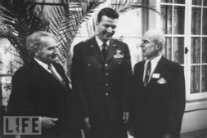
This Course…
The vision for this course is to develop a knowledgeable SMC Team
Examine basic elements needed to build, develop and field space systems
Focus on the interdisciplinary nature of Program Management
Promoting space acquisition management using a simple, real-world focus with a clear emphasis on processes, procedures, functions and how to ORCHESTRATE them

Slide 18
Exercise # 1
Jeopardy

Slide 19
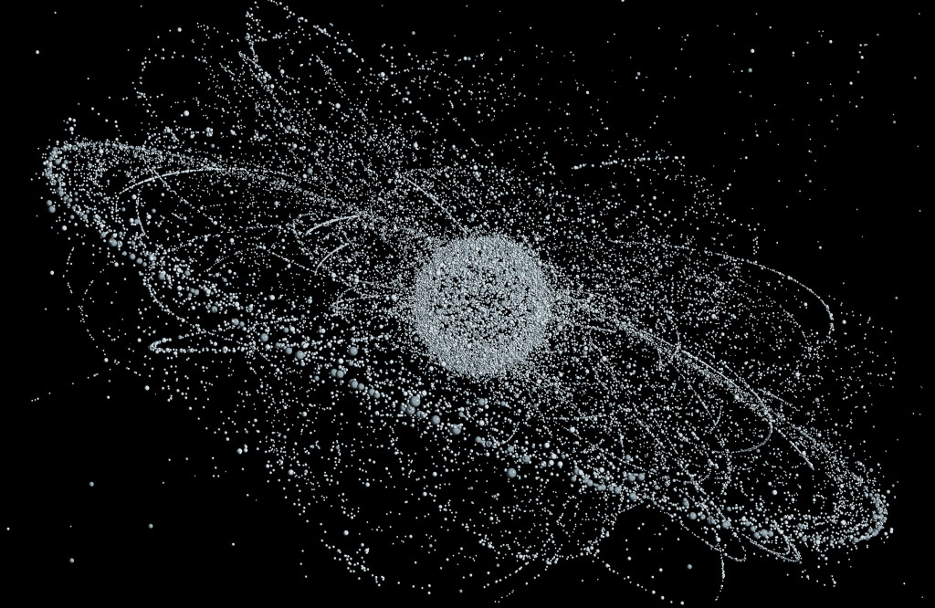
MODULE TWO
Introduction to SMC

Slide 20
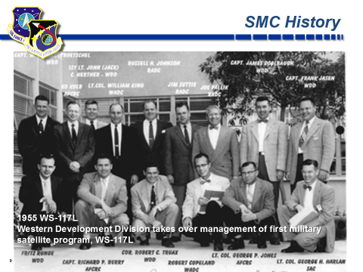
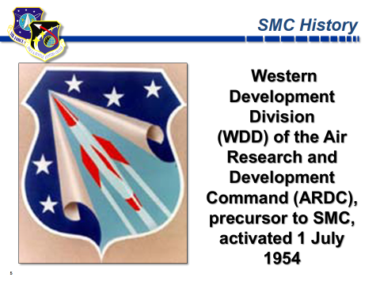
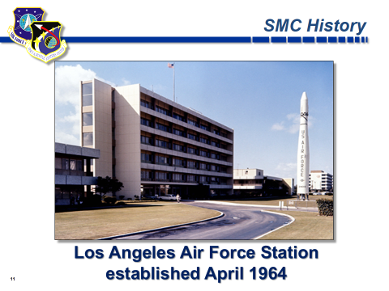
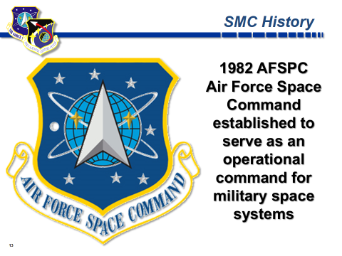
So, Where do We Start???

Slide 21


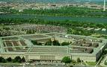

PEO Formation and Current Structure
Packard Commission - 1986
Law / Policy Changes
OSD and Services Implementation
Identified numerous acquisition process shortcomings
Recommended improvements
Legislation
Presidential directives
DoD regulations
OSD created the Program Executive Officer (PEO)
Services given latitude to implement
Air Force PEO has seen change
ASC (AFLCMC) went from one to six PEOs
The Program Executive Officer (PEO):
A corporate operating official; Line officer
Supervises a portfolio of mission-related major & selected programs
Accountable & reports to the service acquisition executive (SAE)
No more than two mgmt levels between PM & DAE (PM->PEO->CAE->DAE)
Streamlines and focuses program execution and oversight
Original implementation – No command responsibilities
PEO for Space:
Continues to retain a very large span of control
In addition, dual-hatted as SMC/CC (Commander)
There was recently a PEO for Space Launch added and then deleted
Space Portfolio
CAE: Component Acquisition Executive DAE: Defense Acquisition Executive
Notes:
The Packard Commission recommended several changes to improve Defense Acquisition; June 1986
The Commission made several recommendations: (1) that defense appropriations should be passed by the United States Congress in two-year budgets rather than annual appropriations bills; (2) the creation of a "procurement czar", to be known as the Under Secretary of Defense for Acquisition and the creation of a clear hierarchy of acquisition executives and managers in each of the services.; (3) the theater commanders should report directly to the United States Secretary of Defense through the Chairman of the Joint Chiefs of Staff; and (4) the powers of the Chairman of the Joint Chiefs of Staff should be strengthened.^{[3]}
Many of the recommendations by the commission were used when Congress reformed the Joint Chiefs of Staff system in 1986 with the Goldwater–Nichols Act.
The Congress took these recommendations and passed legislation to enact them one of which was DAWIA (The Defense Acquisition Workforce Improvement Act)
To shorten the “Chain of Command” with respect to acquisition the program Executive Officer (PEO) was created to meet the requirement of no more than two management levels between the PM and the Defense Acquisition Executive (DAE)

Slide 22
18 Oct 01 Secretary of Defense Memorandum Space Commission Implementation Direction
Delegate MDA for DoD Space to AF
Resolve BMDO & USecAF overlap
Assign SecAF as AE for Space
Establish a “virtual” Space MFP (12)
Appoint USecAF as DNRO
Disestablish ASAF/Space (SAF/AQS)
Realign staff functions under USecAF
Separate AFSPC/CC from CINCSPACE
Reassign SMC to AFSPC
Assign SMC/CC as PEO(Space)
Assign PEO(Space) to USecAF
Establish process for AFSPC/CC to oversee:
Space S&T funds
Space career field
Align AF-NRO Best Practices
Created NSS 03-01
SecDef Message: Single Leader for National Security Space
MDA: Milestone Decision Authority BMDO: Ballistic Missile Defense Organization SECAF: Secretary of the Air Force
USECAF: Undersecretary of the Air Force ASAF: Assistant Secretary of the Air Force AFSPC: Air Force Space Command
CINC: Commander-in Chief S&T: Science & Technology NRO: National Reconnaissance Office NSS: National Security Space
Notes:
In Oct 01, the SecDef formally directed the changes outlined in response to the Space Commission recommendations.
This named the Air Force as the Milestone Decision Authority (MDA) for DOD Space!
The Undersecretary of the Air Force (USecAF) became the Air Force Acquisition Executive (did away with SAF/AQS)!
The USecAF also was named as the Director of the NRO
This was later undone and the USecAF is now responsible only for Space Policy and there is a separate Director of the NRO
As well as SAF/AQS has been reconstituted!
NSS 03-01 was rescinded and Space came under the direction of DODD 5000.1 and DODI 5000.02

Slide 23
Changes Since 2001 Space Commission
USecAF issued Acquisition Policy NSS 03-01 in 2003.
NSS 03-01 created the Defense Space Acquisition Board (DSAB)
March 2005, the USD(AT&L) redesignated all Air Force ACAT IC programs as ACAT ID
moved all oversight and review to DAB.
January 4, 2006, USD(AT&L) redesignated many Air Force ACAT ID programs as ACAT IC
redelegated MDA to the SecAF; USD(AT&L) retained MDA for Space MDAPs.
March 23, 2009, the USD(AT&L) disestablished the DSAB and rescinded NSS 03-01. At the same time, Interim Guidance for Space Systems Acquisition was issued by
USD(AT&L) issued guidance to be eventually incorporated into DoDI 5000.02.
August 25, 2010, SECAF transferred AF space acquisition authority from USecAF to SAF/AQ
realigned the Air Force Space PEO (Director, SMC) reporting to SAF/AQ.
On October 18, 2010, USD(AT&L) approved Directive-Type Memorandum (DTM) 09-025
Space Systems Acquisition Policy (SSAP). Cancelled Interim Guidance, March 23, 2009 and directed that DoDI 5000.02 be amended to establish SSAP.
This DTM applies to all DoD Components.
November 26, 2013, DepSecDef, Ashton Carter, issued interim policy to replace the previous DoDI 5000.02 from 2008 and cancel (DTM 09-025). The interim DoDI 5000.02 addresses space systems in a couple areas:
1) High-Cost First Article Combined Milestone B and C Decisions
2) Orbital Debris Mitigation Risk Report and Post System Functional Review Report
On January 7, 2015, USD(AT&L), Frank Kendall, approved the new DoDI 5000.02 which cancelled the interim version that was implemented November 26, 2013. The new DoDI 5000.02 provides a model to be considered for space

Slide 24
Timeline Space Commission to present
SECDEF
Rumsfeld
Gates
Panetta
Hagel
Carter
Mattis
all Air Force ACAT IC programs as ACAT ID
March 2005
(DTM) 09-025, Space Systems Acquisition Policy (SSAP), DODI 5000.02
18 Oct 2010
Space Commission SECDEF Memo
18 Oct 2001
many Air Force ACAT ID programs as ACAT IC
January 2006
replace previous DoDI 5000.02 from 2008 and cancel (DTM 09-025) 26 Nov
1) High-Cost First Article Combined Milestone B and C Decisions
2) Orbital Debris Mitigation Risk Report and Post System Functional Review Report
BBP 1.0, 2.0, 3.0
2000
2005
2010
2015
2020
USD(AT&L) retained MDA for Space MDAPs
new DoDI 5000.02
1 Jan 2015
transferred AF space acquisition authority from USecAF to SAF/AQ
25 Aug 2010
NSS 03-01
2003
rescinded NSS 03-01
23 Mar 2009
AT&L
Aldridge
Wynne
Krieg
Young
Carter
Kendall
????
(DTM) Directive-type Memo (SECDEF) Secretary of Defense (AT&L) Acquisition Logistics & Technology

Slide 25


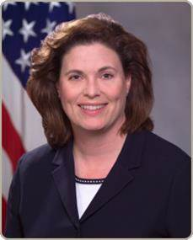

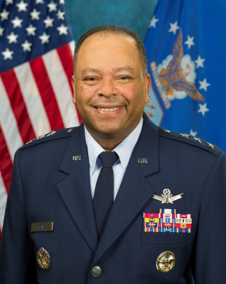
Air Force Space Organization
Heather Wilson
(Nom) Secretary of the Air Force
Lt Gen Arnold W. Bunch Jr. / Darlene Costello
Military Deputy/Civilian Deputy
SECRETARY OF THE AIR FORCE FOR ACQUISITION
Gen John W. “Jay” Raymond
COMMANDER
EXECUTIVE AGENT (EA) for Space
Acquisition Execution
Organize, Train, Equip
LT GEN SAMUEL A. GREAVES
SMC/PEO-SPACE
Space Development,
Acquisition, & Sustainment
Notes:
The current

Slide 26



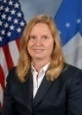



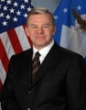
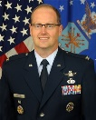


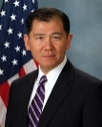
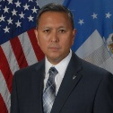


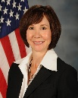
SMC/PEO Space Organization
CENTER
RESPONSIBILITIES
PEO
RESPONSIBILITIES
COMMANDER
PEO SPACE
Lt Gen Samuel A. Greaves
EXECUTIVE
DIRECTOR
SES
Ms Joy White
EXECUTIVE
DIRECTOR
CENTER STAFF
VICE
COMMANDER
BGen Mark A. Baird
LAUNCH
SYSTEMS DIR
Dr. Clair Leon
SPACE
SUPERIORITY
SYSTEMS DIR
Col Phil Garrant
INFRARED SPACE
SYSTEMS DIR
Col Dennis Bythewood
61st AIR BASE
GROUP
Col Charles Roberts
ADVANCED
DEVELOPMENT
& TEST DIR
Col John Anttonen
MILSATCOM
SYSTEMS DIR
Mr. . R Tarleton, SES
GLOBAL
POSITIONING
SYSTEMS DIR
Col Steven Whitney
RANGE
& NETWORK
SYSTEMS DIV
Col Thomas Rock
SPACE LOGISTICS DIR
Mr. Louis Johnson
MISSILE DEFENSE SYSTEMS DIV
Mr. W. Chai
SMC Chief Architect
Col Sean Rucker
CONTRACTING
VACANT
PROGRAM
MANAGEMENT
& INTEGRATION
Mr. Cordell Delapena ,SES
ENGINEERING
Mr. Tom Fitzgerald, SES
FINANCIAL
MANAGEMENT
AND COMPTROLLER
Col Norman A. Dozier
STRATEGIC PLANS &
PROGRAMS
Ms. L. Kennedy
MANPOWER
AND PERSONNEL
Ms. L Young
Notes:
SMC – Led by a 3 Star General – not many people in the military with 3 stars!
Budget is $10B/year
7 large Directorates (& 2 divisions) report directly
Majority are here in Los Angeles: Exception Space Development & Test (SD) (KAFB) & Space C2 & Surveillance (ESC/HIS) (HAFB).
Responsible for 73 space Programs – 16 of which are large ACAT ID programs ($355M+)
The position of Program Executive Officer (PEO) was established in 1986, as a result of the Packard Commission Report. A PEO is typically a General Officer or a Senior Executive Service (SES) civilian equivalent, responsible for the first-line supervision of a group of like programs, each managed by a PM.

Slide 27

Commander’s Intent and Strategic Direction
“To make SMC the most respected, reliable center for responsive and affordable acquisition and sustainment of space systems”
Vision: Be the most respected acquirer and sustainer of space systems
Mission: Deliver resilient and affordable space capabilities for the nation
Notes:
We need to be more responsive to warfighter needs – quickly
SMC should be the one everyone looks to for capabilities

Slide 28
SMC Mandates
& Focus Areas
Mandates:
Deliver warfighting capability by maintaining momentum on improving and executing programs
Focus on making today’s space systems more affordable
Evolve and implement new affordable and resilient architectures
Take care of our people
Focus Areas:
Align SMC’s roles and responsibilities, processes and resources to be more responsive, more cost effective, and more efficient.
Improve SMC’s decision making/governance process
Streamline decision making/governance process
Provide a process for strategic thinking/decision making
Launch a Strategic Communication Campaign
Right size and develop our human resources
Civilian workforce career development planning
Workforce (Military, Civilian, A&AS, FFRDC, SE&I) “Right Sizing”
Military workforce management
Create workforce governance forum for Center allocation of manpower
Quality of life improvements that aide retention and recruiting
Notes:
Be more efficient, cut out unnecessary expenses
Streamline processes, stop wasting time
Correct allocation of manpower
Improve quality of life to enhance retention

Slide 29


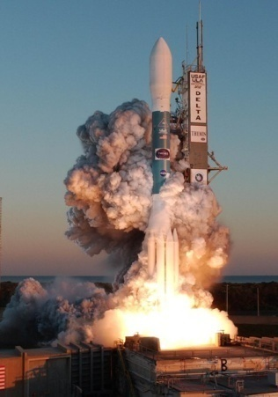
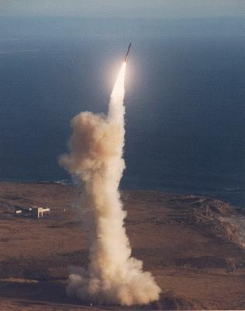
Space Mission Overview
WE DEVELOP, ACQUIRE, FIELD
AND SUSTAIN SYSTEMS IN
FOUR MAJOR MISSION AREAS
Space Superiority
Space Force Enhancement
Space Situation Awareness
- SBSS
- Space Fence
Defensive Counter Space
Offensive Counter Space
Milstar/AEHF/EPS
DSCS/GBS/WGS
GPS
DSP/SBIRS
DMSP
NUDET (Nuclear Detection)
Space Support
Force Application
Launch Systems
Spacelift Range
Satellite Control Network
Conventional Missiles
Prompt Global Strike
Developing, Delivering, and Supporting Military Space and Missile Capabilities to Preserve Peace and Win Conflicts
SBSS: Space Based Space Surveillance AEHF: Advanced Extremely High Frequency EPS: Enhanced Polar System
DSCS: Defense Satellite Communications System GBS: Global Broadcast System WGS: Wideband Global System
GPS: Global Positioning System DSP: Defense Support Program SBIRS: Space Based Infrared System DMSP: Defense Meteorological Satellite Program
Notes:
SMC Mission Overview
Four aspects to Military Space
We touch all 4 areas here at SMC
Bottom line: We acquire, field & sustain Military Space Assets
If it is in Space and Military – likely from here
Note:
(Students will have seen this chart many times before – emphasize the link to program management.)

Slide 30
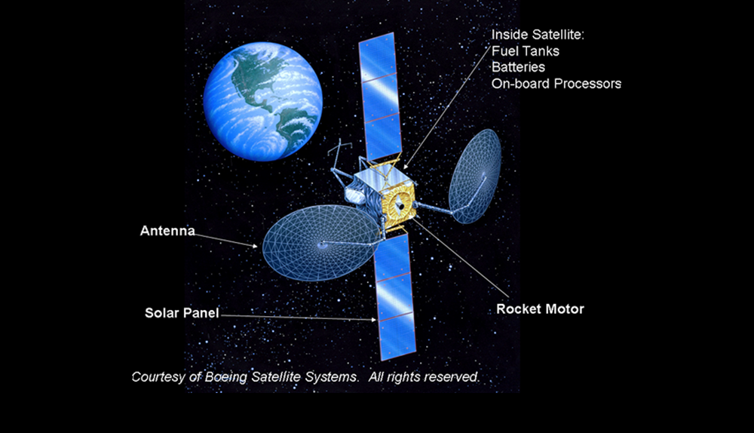
Complexity of Space Products
Environment
& location
Notes:
Defense acquisition projects rank among the most complex of all projects
Much of this complexity stems from the unique environment in which these projects are carried out
Defense acquisition projects are carried out for military purposes thus they have performance outcomes associated with critical life-and-death issues of national security and defense
These projects often incorporate highly advanced technologies
High-tech research and engineering skills usually play very important roles in these projects
Projects are public in that they are managed by public officials and financed with public funds and as a consequence, they are subject to political processes of resource allocation review and oversight
Unique environment best places unique requirements on defense acquisition projects in terms of range of skills and knowledge needed

Slide 31
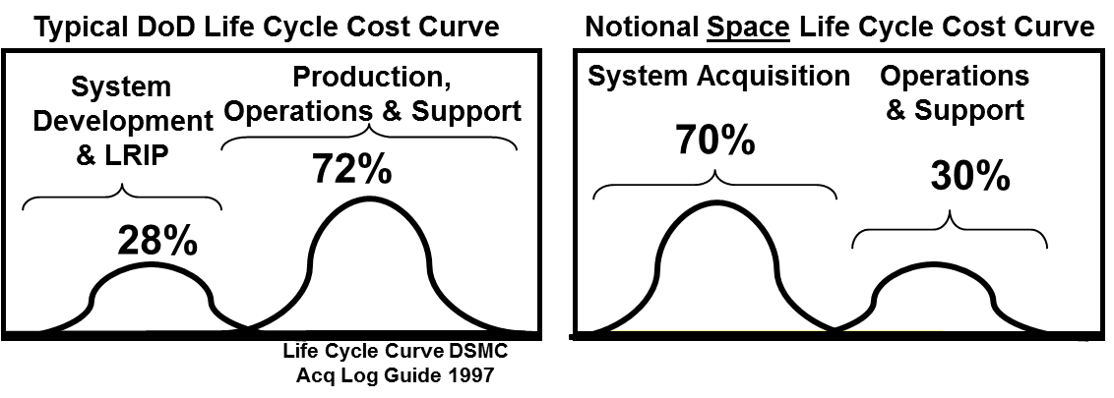
Space Acquisition is Unique
Launch
Develop
Acquire
Requirements/ ConOps Definition
System Concepts
Technology Demonstration
Design/Engineering
Contract
Manufacture/Produce/Code
Assemble, Integration/Test
Space-Ground-User Segment/Integration
Sustain
On-Orbit Constellation Mgmt
Ground Systems
Satellite Anomaly
Evolve
Space/Ground Segments
User Equipment
Majority of SMC Investment Dollars Spent in Systems Acquisition Phase
Notes:
Satellite Systems and Ground Station Systems are different from the typical DoD program profile because the number of systems built is so few.
For the typical DoD program, the Milestone C Low Rate Initial Production (LRIP) decision is very important because it produces the initial Operational Test & Evaluation (OT&E) items, and verifies the production/ manufacturing tools are correct by “manufacturing” a small number (e.g., 5-10) of end article items before committing to the Full-Rate Production decision for what is usually a production run amounting to hundreds of items.
Satellite systems are usually bought in very small quantities of three to five satellites or less for the total buy. Even the 24 satellite GPS constellation is small in terms of production numbers when compared to typical production runs of aircraft, tanks and other DoD weapon systems.
In addition, unlike “typical” major DoD acquisitions, a satellite system usually does not have an acquisition phase dedicated to the creation and testing of two or more on-orbit prototypes by which to base the selection of a winner for the production contract. This is due to the expense of space environmental testing and launch costs. Instead of a “fly-off”, the down-select between satellite system contractors usually occurs at some point during Phase B by having some sort of a “design-off”.
These differences tend to cause the life-cycle cost curve for a satellite system to be front loaded, thus causing the program’s key decision points to be earlier, as depicted in the figure above.
Space Systems are expensive to acquire
Typical DoD acquisitions – large quantities (JSF – 2500 at about $90M a piece) vs. AEHF building 6 – total cost of about $10B
Can’t make one and “test”, if we launch it, it MUST work and deliver capabilities
Limited savings in economies of scale. No opportunity to touch or refuel for 10+ years.

Slide 32

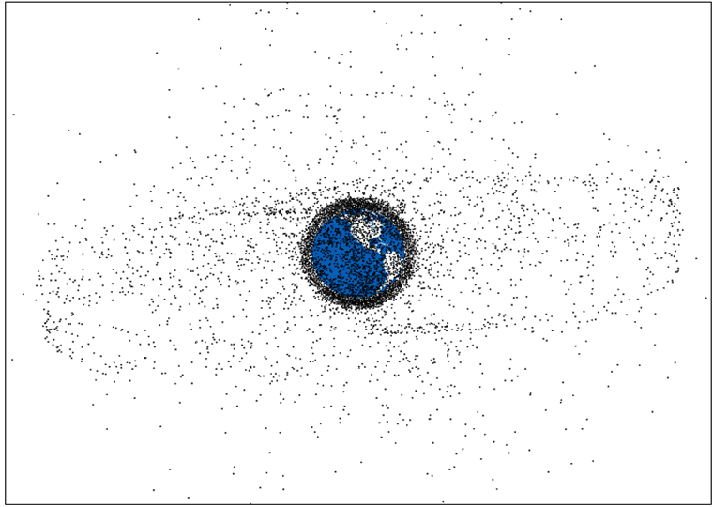
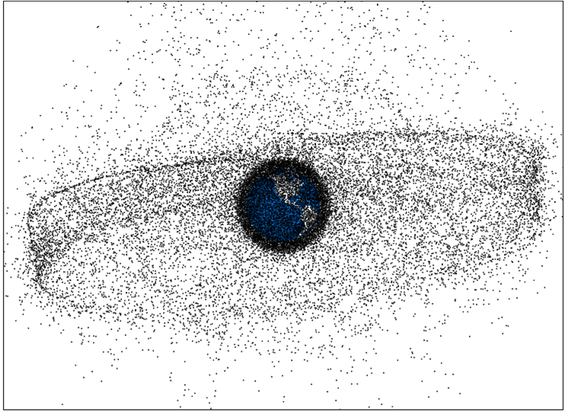
Space Has Fundamentally Changed
Integral Part of Civilian and Military Life
Including: GPS, Communication, Missile Warning, Weather, banking, farming, entertainment, etc..
No longer a US Operating Sanctuary
Contested- Others developing capabilities to attack space systems
Congested- DoD tracking 22,000+ satellites and “space debris”
Competitive- 11 countries operating 22 launch sites; 60 countries or consortia operating satellites
Reduced Funding
DoD budget will be flat at best, and Sequestration impact is still present
Need creative, efficient methods for better capability within means
Maintaining Space Dominance and Superiority Ensures:
Warfighters can navigate with accuracy, communicate with certainty and strike with precision
Commercial applications continue to improve quality of life and strengthen economy
~1961
Current
~2030
Compelling Need For Alternative Space Architectural Options
GPS: Global Positioning System
Notes:
We rely on space – we get annoyed when we can’t find the nearest Starbucks
Imagine the soldier in the field using our products
So many people using space – must keep it free for commercial use as well as for our use
Funding is cut, need efficiencies to accomplish mission – provide capabilities
We owe the warfighter what we can provide

Slide 33

The Ultimate Judge of Our Success
Notes:
Near term-mission assurance, not just get the bird to the pad and into space – ensure the capability is delivered to the warfighter!!!
Do things faster, better, and cheaper
Be creative, alternative architectures
“Just because you’re efficient doesn’t mean you’re effective” – General Pawlikowski
CANNOT sacrifice mission for efficiency, must do both

Slide 34
Exercise #2
What Program am I?

Slide 35
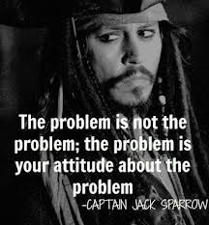
MODULE THREE
The Program Management
Function

Slide 36
Why You Are Here…
This module is designed to give you a “jump-start” in your SMC assignment by outlining:
The PM’s Role
Environment and Relationships
Experience and Competencies
Address career goals for those wanting to become “The PM (Program Manager)”
Notes:
The PM is not the last say, but they are “Responsible”, they have many functions to coordinate in a very dynamic environment. Relationships with all the different functions are a critical piece of the success of a PM.
In order to be effective the PM needs to have experience and a certain level of competence with these functions and Specific tasks and responsibilities you can expect from them
So given this environment, relationships, and a set of competencies how does the PM pull it all off in fulfilling the ROLE!
Your career progression as you gain experience is any easy answer….It depends! So how does a PM succeed at SMC?

Slide 37

Our Purpose
Introduce Structure and Understanding into the PM Career Field to:
Increase Comfort
Strengthen Confidence
Cultivate Learning
Escalate Exposure
Develop Skills
Notes:
Our goal is to add structure to help you to understand what the PM career field is all about.
We want you to feel comfortable and confident that at some point the information that you are exposed to will all start to come together. That date may be months or years from now – you will never stop learning and honing your skills!
Don’t want you to be led to believe that you can’t be a good PM because you are not an engineer--can be from any discipline and be successful, as long as you recognize your weaknesses and work to improve them or know who/where to go to…

Slide 38

Entering Program Management
Entering the New World of Program Management:
What have I gotten myself into?
This is a complex field
There seems to be no standard process
Management Training Methods:
Trial by fire
On-the-job training
Hands-on
Learn by doing
Notes:
Next few days we are going to expose you to the career field you have either chosen or been drafted into.
Many of you are wondering what have I gotten myself into.
While many AF career fields are more structured and have methodical training and education programs, historically PM has not.
It has been: 1.Trial by fire 2. On-the-job training 3. Hands-on 4. Learn by doing
The thought that one could set the ground rules for the job of a PM and then train them to execute, like flying a plan, is not possible. The problem lies with the DYNAMIC nature of the work. Knowing the ground rules, experiencing the execution allows a PM to now how to navigate the charted and uncharted waters of the DOD Acquisition System. So there is much training and much more experiencing to build a SEASONED PM.

Slide 39
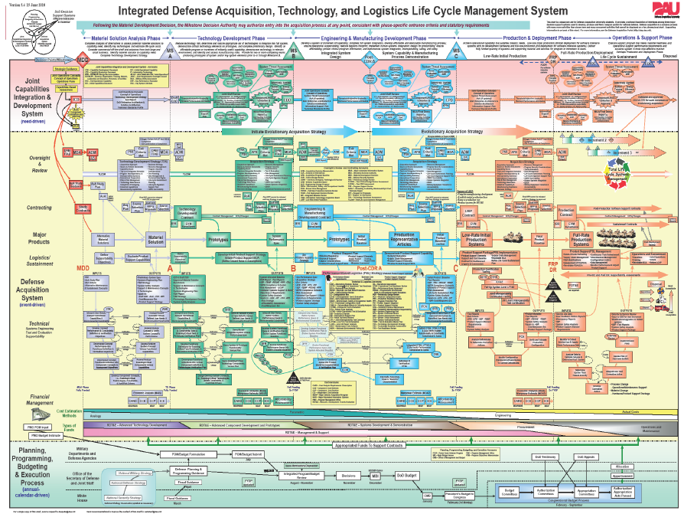
DAU AT&L Life Cycle Management

Slide 40
New Template

Slide 41
Program Manager’s Perspective
PM top of acquisition pyramid
Challenging
Exciting
Rewarding
Notes:
Program managers are responsible and accountable for the coordinated management of numerous related projects directed toward strategic business and other organizational objectives. These programs contain complex activities that may span functions, organizations, geographic regions, and cultures. Program managers build credibility, establish rapport, and maintain communication with stakeholders at multiple levels, including those external to the organization.
PM top of acquisition pyramid
Challenging and requires life long learning
Rewarding and exciting, never dull
Getting people to work together in a team!
But they have several advisors who can keep them out of trouble, but they have to weigh the advice and they are responsible for the final decision.
Exercise #8 PM Tools

Slide 42

Program Manager’s Competencies
Bridge disciplines that it takes to run a project or program:
Financial Management and Program Control
Contracting
Systems Engineering
Technology
Test and Evaluation (T&E)
Logistics and Sustainment
Cyber Security (Systems Security/Information Assurance)
Notes:
Every time you see a list there seems to be another item added….it’s your job to make sure you connect all of them.

Slide 43
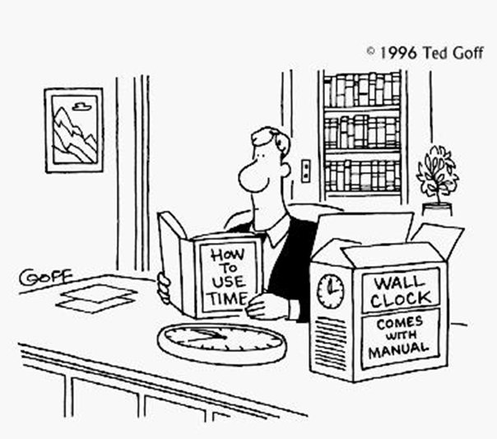
PM Time Management
Expect more work than time permits
Learn to share work within your team; develop good work acceptance/rejection processes
Set clear expectations
Plan for the unknown
Ask appropriately for help and guidance

Slide 44

Program Management Phases
Through:
Initiation
Planning
Executing
Closing
“Be Prepared!”
Notes:
The program manager is responsible and accountable for their program from cradle to grave, throughout the program lifecycle.

Slide 45
What Is the Role of the PM?
Responsible for:
Establishing Goals
Creating Action Plans
Leading Diverse Stakeholders
Coordinating Management of Projects
Monitoring Progress
Know your program!
Notes:
Program managers are responsible and accountable for the coordinated management of numerous related projects directed toward strategic business and other organizational objectives. These programs contain complex activities that may span functions, organizations, geographic regions, and cultures. Program managers build credibility, establish rapport, and maintain communication with stakeholders at multiple levels, including those external to the organization.

Slide 46
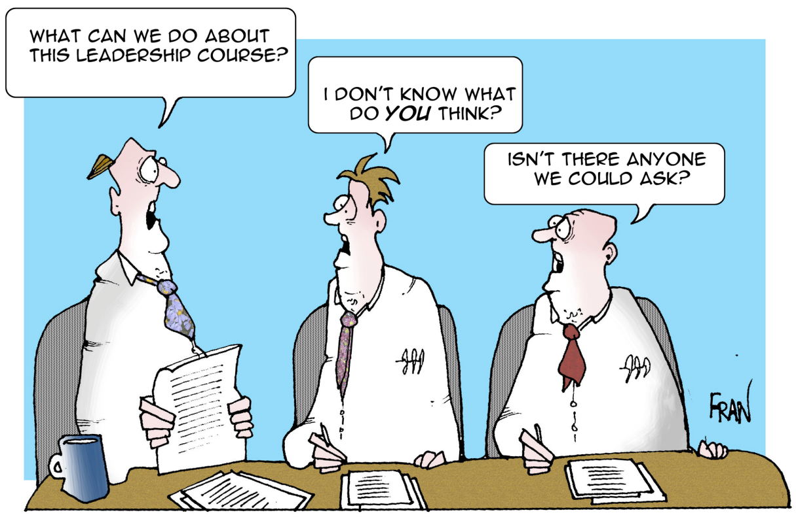
The Program Manager’s Role
The Program Manager is the single leader exercising centralized authority and responsibility for:
Planning
Organizing
Staffing
Controlling
Leading
Program Management is the process whereby a single leader exercises centralized authority and responsibility for planning, organizing, staffing, controlling, and leading the combined efforts of participating/assigned civilian and military personnel and organizations, for the management of a specific defense acquisition program or programs, through development, production, deployment, operations, support, and disposal. DAU Glossary Definition
Notes:
According to the DAU Glossary, Program Management is the process whereby a single leader exercises centralized authority and responsibility for planning, organizing, staffing, controlling, and leading the combined efforts of participating/assigned civilian and military personnel and organizations, for the management of a specific defense acquisition program or programs, through development, production, deployment, operations, support, and disposal.

Slide 47
The Program Manager’s Role
The Program Manager is the one person assigned to lead the program, and in most cases, they alone are ultimately
Responsible and Accountable
for the program’s success
Notes:
(DoDD 5000.01) defines a Program Manager as: The designated individual with responsibility for and authority to accomplish program objectives for development, production and sustainment to meet the user’s operational needs. The Program Manager shall be accountable for credible cost, schedule and performance reporting to the Milestone Decision Authority (MDA).

Slide 48

The Program Manager’s Role
Orchestrator
Facilitator
Integrator
Coordinator
Experience is key to ……success!
Notes:
Department of Defense (DoD) Policy requires that a program manager* be designated for each acquisition program. The role of the PM is to orchestrate, facilitate and integrate the development, production, and initial deployment (as a minimum) of a new defense system. This must be done within the scope of cost, schedule and performance as defined/approved by the PM’s acquisition executive. The PM’s role, then, is to be the agent of the military service or defense agency in the defense acquisition system to ensure the warfighter’s modernization requirements are met both effectively and efficiently.
Orchestrator – orchestrates diverse interests and points of view
Facilitator – facilitates adapting the management system techniques to the uniqueness of the program
Integrator – integrates a complex system of differing but related functional disciplines (business and financial management, logistics, systems engineering, software management, test and evaluation, manufacturing management, etc.) that must work together to achieve program goals
Coordinator – coordinates the people on the team to work together.

Slide 49

What You Can Expect
Develop Your Skills as a Program Manager
Notes:
Next Few Days Packed With Useful Information on Which We Will Evolve You Into a Great potential future PM
So let’s do an exercise to brain storm what kind of management Tools a PM might need.

Slide 50

Requisite Experiences for PMs
Technology (application and strategy)
Requirements (JCIDS process and documents)
Budgets (PPBE, EVM, Appropriations)
Program Phases (Milestones & Lifecycle)
Technical and Requirements Reviews
Program Management Reviews
Milestone Reviews
Test & Evaluation (DT&E/OT&E)
Manufacturing and Production
Operations
Launch
Space/Ground Operations Center
Sustainment & Logistics
JCIDS: Joint Capabilities Integration and Development System PPBE: Planning, Programming, Budgeting and Execution
EVM: Earned value Management DT&E: Developmental Test & Evaluation OT&E: Operational Test & Evaluation
Notes:
During a successful career in Systems Acquisition there are Several experiences that a PM will need to be able to function at the “top of the Pyramid”
Technology is the thing that makes new capabilities possible, do you know where it comes from? What’s your strategy to use it?
REQUIREMENTS are needed to get funding and must be managed using several processes. You need to see this at work. Participating in technical or requirements reviews: SRR, PDR, CRDR, etc.
Nothing happens with out money (BUDGET AUTHORITY), so if you don’t know how to get it and keep it you’ll never get the program off the ground!
So where is your program? In what PHASE? What’s the next Milestone? What part of the program are you in (Initiating/Planning/Executing/Closing)
Being part of Program Management Reviews with the PEO and with the prime/subcontractors
Preparing for milestone reviews and getting all the necessary plans in place
Have you done any Test and Evaluation? It’s basically how you know if you got what you paid for (contracted for)!!
Operations is unique in Space! While most of the USAF trains to fight, we operate daily and sometimes the PM is the lead for an operation!
Launch campaign involves the initial operational part of a satellite and the main operation of a launch vehicle program.
Space/Ground Operations Center

Slide 51

Requisite Experiences for PMs
You are on SMC’s project management “front-line” and must experience the following:
Cost Estimates (POE/ICE/CAPE)
Plans & Schedules (IMP/IMS)
Requirements Management (JCIDS)
Work Breakdown Structure (WBS)
Statement of Work (SOW)
Request for Proposal (RFP)
Risk Management
Technical Evaluations
Source Selection & Contract Award
Integrated Baseline Review
Execution & Reporting
POE: Program Office Estimate ICE: Independent Cost Estimate CAPE: Cost Assessment and Program Evaluation
IMP: Integrated Master Plan IMS: Integrated Master Schedule JCIDS: Joint Capabilities Integration and Development System
Notes:
This course has exercises in the first seven items listed here. We will address the other items, but don’t have time for activities in these areas. It’s not that they are less important, but they are further down the chain of activities in the execution of the program! When you enter a Program Office, they will most likely be doing all of these things at the same time. When you are the PM you will have to know what is happening with all of them!! Joint Capabilities Integration and Development System (JCIDS), Cost Assessment and Program Evaluation (CAPE)

Slide 52

Requisite Experiences for PMs
Acquisition Strategy Development
Building an RFP
Base-Lining a Program After Contract Award
Balancing Cost, Schedule & Performance with Risk Management
Staff Meetings and Management Meetings
PM: Program Manager RFP: Request for Proposal
Notes:
Meetings, meetings, & more meetings. So you better know what they are for, what they must produce and the difference between many of them!
Acquisition Strategy development, a true “art form” or “Black Art” may be a better term. Everyone has an opinion on your Strategy, but as the PM you are the one that must develop, defend and execute it!!
Building a draft RFP
Data items, specs, standards, criteria for selection…..lots of moving pieces and parts….it takes a village to build one!
Base-lining a program after contract award
Flow-down of requirements
EVMS – Earned Value Management System
Scheduling
Work packages
WBS – Work Breakdown Structure
Make or buy and subcontract management plans
Program success metrics
IMP/IMS – Integrated Master Plan/Integrated Master Schedule
RISK MANAGEMENT is the tool to keep the TRIANGLE in balance.

Slide 53
Exercise #3
Who Wants to be a
Program Manager?

Slide 54

MODULE FOUR
Program Management
Basics

Slide 55
Program Management Basics
Defines project and program management concepts and responsibilities
Learning objectives: Promote an understanding of--
Characteristics of a project
“Triple constraint” and its impact
Interdisciplinary nature of project management
Generic project lifecycle and typical management activities in each phase*
Defense Acquisition Program Lifecycle and typical management activities in each phase*
* These are where you will first see the UNIQUENESS of “Space Acquisition”

Slide 56
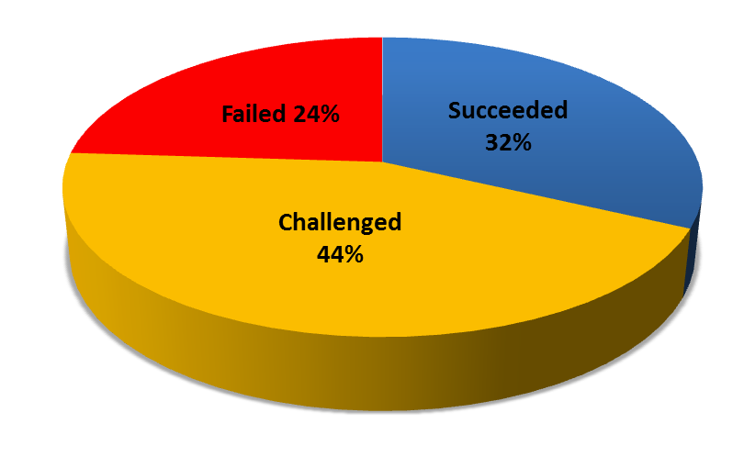
Project Management Implications
Why the emphasis on Project Management?
Gartner Group 2003 study indicated 75% of I.T. projects fail
The Standish Group “Chaos Summary 2009” shows “…a downtick in the success rates from the previous study, as well as a significant increase in the number of failures
Only 32% of all projects succeeded
44% were challenged
24% failed
The High Cost of Low Performance (2014); reveals that only 52 percent of government strategic initiatives meet their original goals and business intent
http://www.pmi.org/~/media/PDF/Business-Solutions/program-management-success-goverment-study.ashx
Most Studies implicated project management as one of the primary causes of failure or at least a major source of problems
IT: Information Technology
Notes:
Only 32% of all projects succeeded: on time, on budget, with required features.
44% were challenged: late, over budget, and/or with less than the required features.
24% failed: cancelled prior to completion or delivered and never used
"These numbers represent …. A low point in the last five study periods. This year's results represent the highest failure rate in over a decade“
Program management evolved as a discipline because of a need to coordinate resources and technology to secure predictable results
VB Columnist Joe Kunk, 3/16/2011; “Developer mistakes are relatively easy to remedy compared to poor planning, a lack of leadership, bad estimates or the impact of unanticipated risks. These are failures in communication, requirements specification, project scope and risk management, respectively.
Project Management Concerns
- What does the user want and why? What are the scope, benefits, costs, and priority? Should it move forward?
- Have all the important factors been considered before decisions are made and costly action is taken?
- What is the best architecture and design that meet the users’ needs? What will it cost and how long will it take to deliver a particular set of desired features?
- Ensure project risks will not derail the project. If something does go wrong, what did and why?
- What staff and technical resources are needed for the project so they can be properly scheduled and funded?
- How will it be demonstrated that the features are implemented as agreed without bugs?
- How will the system be implemented and any existing data migrated?
- What support will be required to keep it functional and useful? Backups? Network?
- How will users be trained in its use?
SCRUM Development!
Scrum is an iterative and incremental agile software development methodology for managing product development. It defines "a flexible, holistic product development strategy where a development team works as a unit to reach a common goal"^{[this quote needs a citation]}, challenges assumptions of the "traditional, sequential approach"^{[this quote needs a citation]} to product development, and enables teams to self-organize by encouraging physical co-location or close online collaboration of all team members, as well as daily face-to-face communication among all team members and disciplines in the project.
A key principle of scrum is its recognition that during production processes, the customers can change their minds about what they want and need (often called^{[by whom?]} "requirements churn"), and that unpredicted challenges cannot be easily addressed in a traditional predictive or planned manner. As such, scrum adopts an empirical approach—accepting that the problem cannot be fully understood or defined, focusing instead on maximizing the team's ability to deliver quickly and respond to emerging requirements.

Slide 57


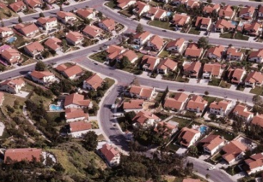
Definition of Project
A "project" is anything not likely to be finished in one action step, or in one sitting… e.g. – Building a house
“…a temporary endeavor undertaken to create a unique product, service or result”
Projects are temporary
They are unique
Programs refer to groups of related projects
Notes:
Projects are temporary – they have a beginning and an end
They are unique – each project has characteristics that are different from the others
Programs refer to groups of related projects that are managed in a coordinated way to obtain benefits control
Program management can be defined as the process of managing several related projects, often with the intention of improving an organization’s performance or meeting a user’s need

Slide 58


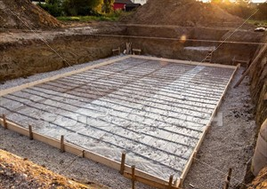

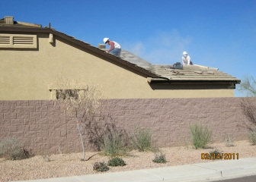
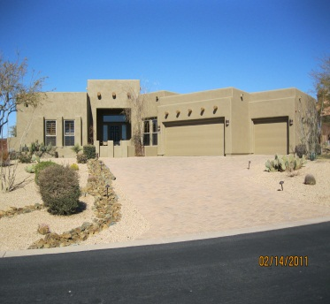
Characteristics of a Project
Lifecycle
Interdependencies
Precedence
Conflict
Project Management Definition:
Application of knowledge, skills, tools, and techniques to project activities to meet project requirements
Notes:
Lifecycle – Various phases through which the project progresses
Interdependencies – Task are independent of each other and must be accomplished in a certain sequence
Conflict – Tasks compete with each other for same limited resources
Temporary Unlike Routine Operations which are ongoing repetitive and routine. Routine operations are focused on continuously sustain the mission of the organization where as projects are focused on attaining the project objectives and then terminating
So managing the project calls for a set of knowledge, skills, tools and techniques and how they Are best applied to accomplishing the end product desired whether it is a satellite that provides communications or a house that can become a HOM

Slide 59



Project Management Skill Set Commonality
Program
Management
Cost
Schedule
Mfg &
QA
Performance
Finance
General
Contractor
Bank
System
Eng
Architect
Contract
Logistics
Contracts
City
Inspector
Test &
Evaluation
Safety
Project management concepts and skills are, in general, universally applicable to different disciplines and fields of work
Mfg: manufacturing QA: Quality Assurance Eng: Engineering
Notes:
Requirements =
How much performance do you need – what does it have to provide?
How much time do you have to affect a solution
How much $ you can afford to spend on it
Common program management tasks include:
Establishing Objectives
Breaking work into well-defined tasks
Charting the sequence of tasks
Scheduling
Budgeting
Coordinating a team
Reporting
Communicating throughout the project

Slide 60
Project Management Universal Body of Knowledge
Many management knowledge areas, skills, tools and techniques also apply to routine operations
Communications
Risk identification
Procurement
Human resources
Quality
Cost(s)
Time (schedule)
Performance (Requirements & Scope)
Notes:
Program managers manage specific tasks and resources against a time-oriented set of objectives. The budgets are associated with defined work, within a specified time frame. Labor resources are often led by people to whom they do not report. It’s not so much what PM’s manage, but rather the way a PM manages, and the measurement and control practices involved in the task. There are many areas of program management, however the eight major components include:
Communications – The analysis of the communication requirements determines the information needs of the project stakeholders. These requirements are defined by combining the type and format of information needed with an analysis of the value of that information. Project resources are expended only on communicating information that contributes to success, or where a lack of communication can lead to failure.
Risk identification – The process of determining which risks may affect the project and documenting their characteristics.
Procurement – The procurement documents (Input/Output) utilized in bid and proposal activities, which include the Invitation for Bid, Invitation for Negotiations, Request for Information (RFI), Request for Quote (RFQ), Request for Proposal (RFP) and seller’s response. A Procurement Management Plan is a document describing how procurement processes from developing procurement documentation through contract closure will be managed.
Human resources – The human resource plan as part of the project management plan, provides guidance on how project human resources should be defined, staffed, managed, controlled, and eventually released.
Quality – The organizational assets that influence the Plan Quality process include, but are not limited to:
Organizational quality policies, procedures and guidelines
Historical databases
Lessons learned from previous projects
Quality policy, which sets the intended direction of a performing organization with regard to quality
Cost – includes all funds required to design, develop, produce, operate, support and dispose of the system
Time/Schedule – consists of the time it takes to design, develop, produce, and deploy a fully supported system
Scope – is the degree to which a system can be expected to perform its mission in combat

Slide 61
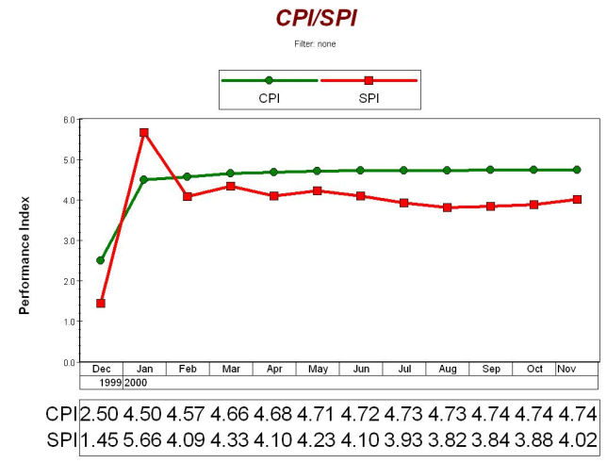
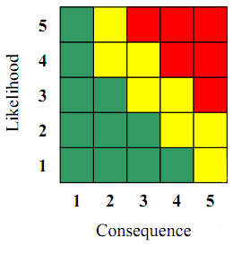
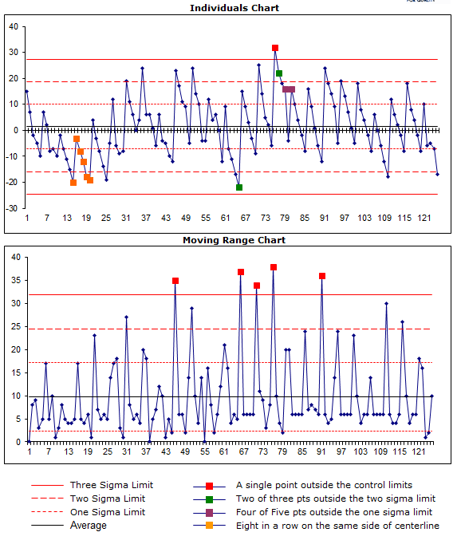
Project Management Unique Body of Knowledge
Unique management knowledge includes:
General business management knowledge areas
Particular applications involved in a specific project
Risk management
Project performance management, etc.
Manufacturing and QA processes
CPI: Cost Performance Index SPI: Schedule performance Index QA: Quality Assurance
Notes:
The unique things that are applied to SMC Program Management include:
The COST PERFOMANCE REPORT (CPR) , or COST FUNDS STATUS REPORT (CFSR), these are the reports and analysis that are based on Earned value management.
RISK MANAGEMENT uses the standard 5X5 “Risk Cube” – we’ll address that a bit later
When production starts the data used to manage the products compliance to requirements and the quality are unique to every different production/manufacturing process

Slide 62
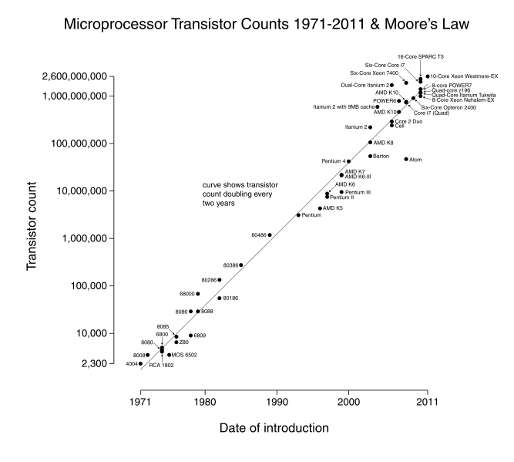
Project Management Project Specific Body of Knowledge
Particular applications involved in a specific project
Information Technology (IT) Projects
Software project management
Information Assurance
Keeping up with – “Moore’s Law”
Services
Commercial Satellite Communications & Imaging
Launch
General Contractors (building that House!)
Graph source: Wikipedia
Notes:
Most projects have unique attributes that have spawned a variety of tools and methods that are unique to the issues that require management attention
Information Technology (IT) project management has a unique set of DOD requirements that make the Acquisition Category (ACAT) into a Major Automated information System (MAIS) program
A unique concern with IT is the connection to the World Wide Web (WWW) and hence the need to protect access to and information from leaving those areas. This area of endeavor is known as “Information Assurance”
Whenever any program involves computers there is a law that the PM must be aware of – “Moore’s Law” The graph depicts that the capability doubles every two years!
The Service program also have their unique body of knowledge required, sometimes it is “Rocket Science!”
See if you can find the unique bodies of knowledge needed as we go through our “Building a House” analogy.

Slide 63
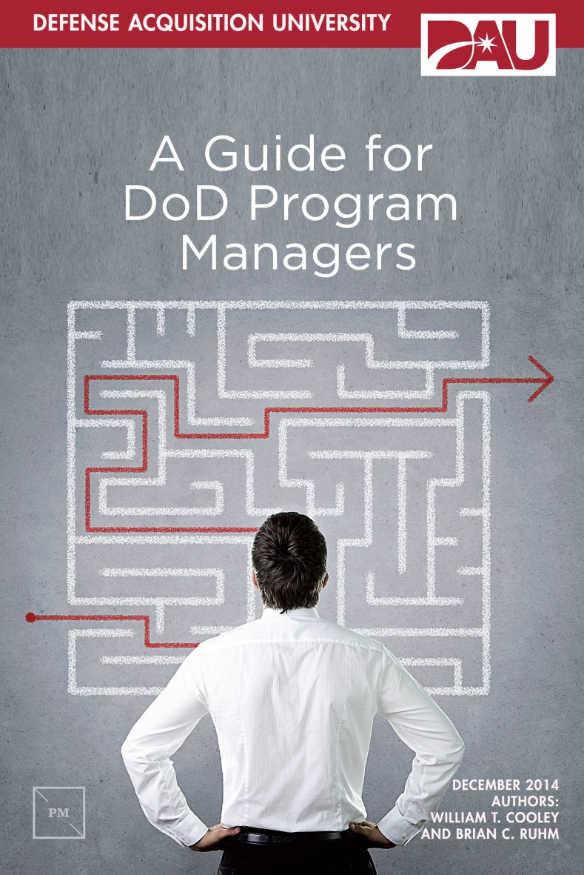
PM Book by BGen Cooley “written for an O-5 to O-6 entering into a PM Position”
“The first responsibility of the key leaders in the acquisition workforce is
to think.”
—Frank Kendall
Under Secretary of Defense for
Acquisition, Technology, and Logistics
Framework
Basics (Cost, Schedule, Performance, Risk)
Tools of the Trade
Financial Management, The Contract, Systems Engineering (Functions)
Others (Battle Rhythm, Earned Value Management, External/Independent Reviews)
Critical Artifacts
Acquisition Strategy
Acquisition Program Baseline (APB)
IMP/IMS (Integrated Master Plan/Schedule)
Intangibles
Integrity, Leadership, Collaboration, Compromise
“What does a PM do?”
“…our belief that program management is a
thoughtful discipline that does not lend itself to dogma, “cookie-cutter”
solutions, or one-size-fits-all processes.”

Slide 64
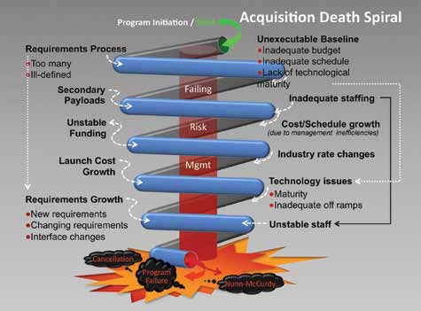
High Frontier, Volume 7, Number 4; August 2011; “Escaping the Space Acquisition Death Spiral, Part One of a Three Part Series”,
Col James D. Rendleman, retired and Mr. J. Walter Faulconer

Slide 65
Warning Signs
“Program managers must, therefore, be wary and prepared to detect the distinct Warning Signs of impending program doom, and take immediate action to confront them. They are:”
Failed systems engineering
Unrealistic funding realities, including incomplete budgets or volatile program funding
Unreasonably pushing the technology envelope, with unstable requirements.
Overly optimistic planning estimates, with weak program cost and schedule reserves
Launch vehicle selection driving program complexity
Unreasonable “sunk-cost” arguments
Government/customer is not acting and thinking strategically
Faltering industrial base
Stunts being used as a substitute for mission value
High Frontier, Volume 7, Number 4; August 2011; “Escaping the Space Acquisition Death Spiral, Part One of a Three Part Series”,
Col James D. Rendleman, retired and Mr. J. Walter Faulconer

Slide 66
Recent Examples of “The Death Spiral”
Space Based Infrared System (SBIRS)
• Started without enough money or resources; government systems engineering capabilities lost.
• Hardware systems and software engineering shortfalls generated budget and schedule failures.
• Setbacks when flight software failed testing and ground support equipment experienced problems.
• Continuing, compounding problems served as an impetus to restructure SBIRS several times.
National Polar-orbiting Operational Environmental Satellite
System (NPOESS)
• Significant technical, cost, and scheduling problems.
• Was originally estimated to cost about $6.5 billion over a 24-year life. After its restructure, NPOESS was estimated to cost $12.5 billion over a 32-year life.
Advanced Extremely High Frequency (AEHF) Satellite System
• Cost overruns and schedule slips.
• As of 2009, total cost was supposed to be $10.3 billion for only 4 satellites, a per-satellite-unit cost increase of 109.3 percent. Research and development costs jumped 51.7 percent, from $4.75 billion to $7.2 billion.
• Procurement costs spiraled upwards even faster. From an initial estimate of $1.4 billion for five satellites (with an average of $281 million per satellite), procurement costs rose to $3.1 billion for
four (each now averaging $775 million each, a whopping 175.8 percent increase).
• Some overruns blamed on “US National Security Agency’s failure to furnish key cryptography requirements and specifications, and to significant mechanical and construction difficulties.”
High Frontier, Volume 7, Number 4; August 2011; “Escaping the Space Acquisition Death Spiral, Part One of a Three Part Series”,
Col James D. Rendleman, retired and Mr. J. Walter Faulconer

Slide 67



What is the picture of your MANAGEMENT
Leadership
Management Style
Change
Management

Slide 68
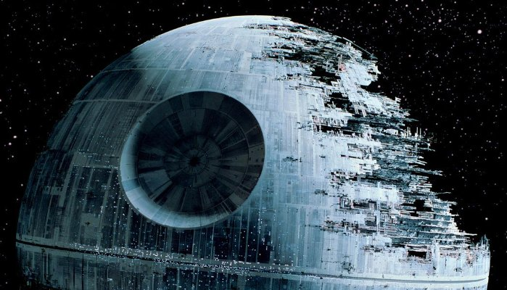
MODULE FIVE
The Triple Constraint

Slide 69

The 5 Biggest Reasons Projects Fail
Eyes are bigger than your budget
Working with the wrong talent
Continuing to pursue bad ideas
Death by committee
Keeping the final approver in the dark
Source: http://www.entrepreneur.com/article/246279, MIKE TRIGG, CONTRIBUTOR COO of Hightail, May 2015.
Notes:
1. Eyes are bigger than your budget.
We'd all love to run a Super Bowl ad, but you can’t do it on a shoestring budget. And while businesses need goals and dreams, leaders need to temper them with a healthy dose of reality and expectation setting. This helps make it clear what you can actually achieve given your available time, resources and budget.
Related: Keeping Clients Happy: How to Ensure a Project Doesn't Go Over Budget
Recognizing your constraints can lead to unexpected benefits. When the founders of 37 Signals began work on their signature product Basecamp, they made an honest assessment of how much time each person could invest. As most of the founders still had full-time jobs, their time constraints forced them to develop a feature-lite project management tool. This simplicity turned out to be one of the major factors behind the success of the app.
To avoid misaligning dreams with reality, your business needs a culture of honest communication that encourages clear-sighted discussion across all levels, instead of just having unquestioned orders flow downstream.
2. Working with the wrong talent.
Whatever the project, a company’s first instinct is to put an in-house team on it. After all, that’s what they’re there for, right? But just because someone is part of your company doesn’t mean they’re the right person for a specific project.
The key is to be honest with yourself and your employees and, if necessary, look outside your core team to find the best people for a project. Start building relationships now with agencies, contractors and consultants so you have a network ready to fulfill specialized tasks when the time comes.
3. Continuing to pursue bad ideas.
In Hollywood, they say it’s easy to make a bad film from a good script but impossible to make a good film from a bad script. Though you won’t always recognize a bad idea straight away, once you do, never assume that you’ll make it work or believe that you’ve put in too much effort to change course.
I once worked with an external agency on a series of digital ads but after a number of designs, tweaks and iterations, I still couldn’t convince myself that we’d hit gold. Eventually I realized that the visual approach we had agreed upon at the beginning of the project was wrong. After we decided to start over and work with a brand new set of stylistic references, the project came together very quickly.
Related: The 'Hard-Stop' Method Can Help You Save Time and Money on Testing New Ideas
The minute you recognize that an idea won’t work, you have to pull the plug. It’s usually impossible to retrieve a bad idea, and you’ll only waste time, money and energy trying to put lipstick on a pig.
4. Death by committee.
A project often has multiple parties interested in its outcome and groups may even have divergent goals and expectations. I once spent weeks working with a designer and copywriter on a website homepage redesign, only to have our carefully-crafted work dismantled by the company’s various heads of department demanding changes to meet their individual needs. Our problem was that we failed to establish who owned the project and therefore didn’t deal with potential conflicts and disappointments in advance.
Renowned animation studio Pixar has a large group of people it calls the “brain trust” that meets to review films at different stages of production. Though the committee’s job is to provide notes on potential problems and offer solutions, none of the advice is mandatory. The film’s director retains complete control over the final product.
Feedback is an essential stage of any project. But decision-by-committee rarely leads to the best outcome. Every project should start by establishing clear, workable goals and give one person the ultimate ownership and accountability for meeting them.
5. Keeping the final approver in the dark.
Typically the bulk of work on a project happens below the level of the final approver. You often get a situation where, for example, a freelancer works closely with their contact at a company to complete a piece of work, only to hear the dreaded words: “now I just have to run this past my boss.” I call this “the contractor’s nightmare”.
As someone who is often the boss, I find it remarkable that I am expected to just give a thumb up on a final version that I saw at the end of the project. In reality, my first experience of a project is likely to produce lots of questions, comments and suggestions. While I don’t believe in micromanaging talented people, being able to review a project at certain set stages makes for a better overall process.
When beginning a project, establish clear checkpoints for the ultimate approver to provide feedback. This will help ensure a smoother path to the finish line.
Applying these suggested preemptive strikes and remedies should help you avoid catastrophe on your next big project.

Slide 70

The Triple Constraint
While monitoring and controlling:
Cost
Schedule
Performance
How much risk are you willing to take?

Slide 71

Project Constraints
Cost
Schedule
Performance
Notes:
Requirements =
How much performance do you need
How much $ you can afford to spend on it
How much time do you have to affect a solution
The primary impact of project constraints is the likelihood of delaying the completion of the project.
There are three types of project constraints: technological, resource and physical.
The technological constraints relate to the sequence in which individual project activities must be completed.
For example, in constructing a house, pouring the foundation must occur before building the frame.
Resource constraints relate to the lack of adequate resources which may force parallel activities to be performed in sequence.
The consequence of such a change in network relationships is delay in the completion date of the project.
We will examine the nature of resource constraints in much greater detail in the next section.
Physical constraints are caused by contractual or environmental conditions.
For example, due to space limitations an activity such as painting a wall may have to be performed by only one person (Gray and Larson, 2003).

Slide 72
“Triple Constraint” Concept
A method to conceptualize project management key parameters
Product Performance
Specified Attributes
Cost
Schedule
Budget
Time
Notes:
Solution Box

Slide 73
“Triple Constraint” Key Parameters – Cost
Product Performance
Specified Attributes
Cost
Schedule
Budget
Time
Regardless of performance or schedule, projects need funds to complete the work – even projects that use only labor need funds; someone, somewhere is paying

Slide 74
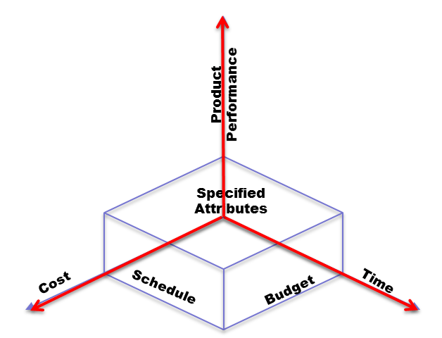

How Much Will It Cost?
Good estimates clearly define:
Project scope
Assumptions made
How long the estimate is valid
Project cost based on current information
Confidence Levels in estimates increase as the project matures.
Project estimates start out broad and are refined as project deliverables are better defined

Slide 75

Cost
“Consider relationship between cost and risk”
Provide
Range of variance
Explanation of how the estimate was created
Level of confidence in the estimate
Failure to do so leads customer to believe that the price you've "promised," is the final price…..regardless of what they do!
Notes:
We can't know the final project cost until the project is complete because we can't accurately predict the future…
Therefore it is important to know what confidence level the estimate was calculated with!

Slide 76
Cost
Three cost estimating techniques/methodologies:
Parametric
Analogy
Build-Up
Note that other names may be used to indicate these methods

Slide 77
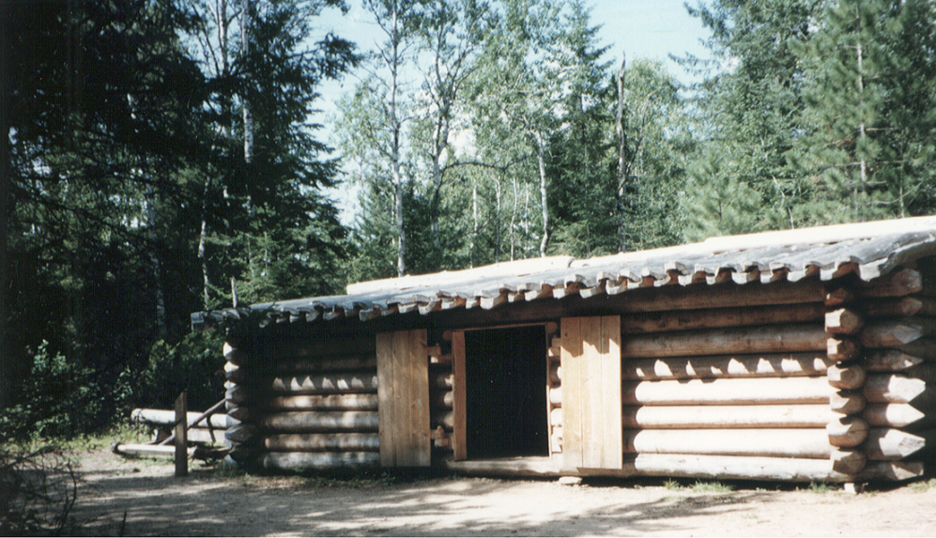

Cost Estimates
Parametric Estimating – a mathematical
relationship between a parameter and cost
Such as $ per Square Foot
Or $ per Bedroom
$
$$$
Sometimes referred to as a “Cost Estimating Relationship” CER
Notes:
Parametric:
Parameter may be physical, performance, operational, programmatic, or cost
Uses multiple systems to develop relationship
Allows statistical inferences to be made
Requires a good database which is relevant to the system being estimated
Excellent for use early in program life cycle before a detailed design exists
Used as the design progresses to capture changes
Good as a cross-check for other methods
(Woek Book, exercise #4)

Slide 78


Cost Estimates
Analogy – based on budget info from a similar project and applied to the current project – a bit more accurate!?
$$
$$+X
Even though it looks like an equation, it’s an ANALOGY!
Notes:
Analogy Application
Used early in the program life cycle
Data is not available to support using more detailed methods
Not enough data exists for a number of similar systems, but can find cost data from a single similar systems
The best results are achieved when
Adjustments can be quantified
Subjective adjustments are minimized
Similarities between old and new systems are high
Minimize differences to one or more that can be scaled, then
Minimize the amount of scaling (size of adjustment factor)
Can be used as a cross check for other methods
(Workbook exercise #4)

Slide 79
Cost Estimates
Build-Up– a deliverables-oriented decomposition of the project scope – very detailed method – uses a work breakdown structure (WBS) or bill of materials (BOM)!
Lot $75,000
Lot Prep $15,000
Slab $12,000
Framing $17,000
Roofing $18,000
Plumbing $13,000
Electrical $13,000
Finishing $22,000
Cabinets $22,000
Flooring $12,000
Painting $10,000
Landscape $75,000
Permits $ 2,000
Etc.
NOTE: Usually requires a completed DESIGN! (e.g.; CDR)
WBS: Work Breakdown Structure BOM: Bill of Materials CDR: Critical Design Review
Notes:
Estimating is done at lower levels and results rolled up to produce higher-level estimates
Often the lowest definable level at which data exist
Elements of this method could include:
Standards
Time and Motion Studies
Well defined work flow
Variance Factors
Parts List
Lot Size and Program Schedule considerations
Program Stage
Support Labor

Slide 80
Cost Estimates
Lifecycle Cost
Mortgage $ 60,000 per year
Property tax $ 3,500 per year
Insurance $ 2,000 per year
Maintenance $ 1,000 per year
Electricity $ 3,600 per year
Gas $ 600 per year
Water $ 1,000 per year
Total $ 71,700 per year
30 X $71,700 = $2,151,00
Price $351,000
Interest $286,910
Total $637,910
Notes:
Must include operating costs
With complex systems there also exists training and currency costs

Slide 81

Exercise # 4
Cost Estimates

Slide 82
MODULE SIX
Financial Management
(SMC/FM)

Slide 83




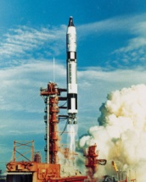
What is Financial Management?

Slide 84
Our Job is to …
Balance requirements and funding
Defend program and respond quickly to “What ifs”
Execute program
Track funding
Keep you and ourselves out of jail

Slide 85
Air Force Financial Management is:
The process of:
Determining funding requirements
Obtaining resources
Effectively and efficiently applying resources to meet Air Force mission and support responsibilities
Reporting on funds usage
Support audits (GAO, DCAA, FIAR)
Financial Improvement and Audit Readiness (FIAR)
Financial Analysis Is Key Component Of Financial Management
GAO: Government Accountability Office DCAA: Defense Contract Audit Agency

Slide 86
Financial Analysis
Financial analysis provides integrated picture for program decision making
Facilitates understanding of cost/schedule/
technical impacts of decisions to budget/financial health of the program
Glue that brings all aspects of the program together so management has right information to make right decision
Increase effectiveness of program execution and planning
Any changes in the program impact the financial resources
Critical Member Of The Decision Process

Slide 87
Financial Environment
Budget Instability
Program Phase
User Expectations
Industrial
Base
Financial /
Cost
Analysis
“Conspiracy of Hope”
Conflicting Expectation
Public Trust
Contract Types
Promises vs Reality
Past Performance
Political
Issues
Notes:
Cost Estimators must operate in a very complex environment.
A high performing cost estimator needs to be able to effectively deal with this environment, as well as crunch numbers.
Realistic cost estimates are usually in the best interest of the program in the long term; however, our reward system is sometimes heavily weighted on the short-term goals (like getting a new program started). This creates an inherent conflict that cost estimators must deal with on a daily basis.
Example
As a cost analyst sometimes you feel like you are in a “no win” situation. If you provide the most objective picture you can., sometimes your analysis does not support what your boss may want to do.

Slide 88
Financial Management & Comptroller Functions
Integrated Decision Support using:
Financial Analysis
Budget Analysis
Cost Analysis
Earned Value Analysis
Stewards of Taxpayer’s Money
Notes:
Each program is structured differently. In some programs the financial analysts perform all of above functions. In other programs (especially very large programs) there may be financial, cost and earned value analysts.

Slide 89

What is Program Control?
Typically PM for all financial activities
Definition: Manages integrated cost and schedule performance data at all program levels to forecast and monitor program execution -- relates time-phased budgets to specific tasks identified in the statement of work
Role: Manages program data, accurately affirming:
Status relating to cost, schedule and technical accomplishment; and
Data that is valid, timely and auditable
Benefit: One-stop business operations office

Slide 90
Program Control
Universal role
Emphasis is on budget execution and management
Responsible for providing an extensive range of planning, reporting, financial, cost estimating, scheduling, and analytical
Central integrating and unifying function, manages and controls many key program processes – for business, information, cost, schedule, budget and internal control.
Maintains close relationships with all program segments (contracts, engineering, test, quality, etc.) and closely manages schedule/ budget execution
Provides independent progress and risk assessments to program management in parallel with segment direct reports
Objectivity and integrity must be key Program Control attributes to ensure optimal decision support to the PM and service to the program and the Air Force.

Slide 91
Program Control Office Roles And Responsibilities
May include the following, as directed:
Audit Focal Point
Baseline Control
Budget Management
Cost Estimating
DAMIR (Defense Acquisition Management Information Retrieval) for DAES/SAR reporting
Document Control Manager
Earned Value Management (EVM)
Financial Risk / Health Analysis
Integrated Risk Analysis
Process / Information Control
Program Execution Group (PEG) / Commander’s Action Group (CAG)
Program Execution Reviews
Program Management Reviews (PMRs)
Program Planning
Scheduling and Schedule Analysis
Strategic Communications
DAES: Defense Acquisition Executive Summary SAR: Select Acquisition Report
Notes:
Audit Focal Point - Serves as liaison between auditors and program personnel
Baseline Control - Uses the Acquisition Program Baseline (APB) to enhance program stability and provide a critical reference point for measuring and reporting program status
Budget Management - Assists the PM with the PPBE process
Cost Estimating - Applies cost, economic, financial, and business case analysis policy and guidance; participates in cost and technical data collection efforts; chooses appropriate cost estimating methods and model development projects; and, monitors program cost and schedule using Earned Value Management (EVM)
DAMIR (Defense Acquisition Management Information Retrieval) - Serves as the single configuration control and data control point for yearly SAR, quarterly DAES, and APB info.
Document Control Manager - Ensures the proper recording, monitoring, and reporting of key program and acquisition-related documents for the program
Earned Value Management (EVM) - Provides subject matter expertise for policy interpretation, implementation, compliance, oversight and enforcement on all matters related to EVM for the program. Applies EVM in accordance with DoD and all other HHQ policy and guidance
Financial Risk / Health Analysis - Conducts analyses of contractors’ financial health using standard finance and investment calculations to assess contractors’ ability to perform
Integrated Risk Analysis - Identifies and dollarizes engineering and cost risks; provides analysis that incorporates schedule risk as well as the traditional cost risk elements
Process / Information Control - Manages process or information control or acts as the process or information controller
Program Execution Group (PEG) / Commander’s Action Group (CAG) - Serves as liaison between the Program and higher levels of management
Program Execution Reviews - Conducts internal reviews of program execution and continuously compares funding and budget against approved and potential requirements
Program Management Reviews (PMRs) - Facilitates external reviews for the program and responsibilities include template design, Quality Control, scheduling, and pre-briefs
Program Planning - Verifies the quality and compliance of all documentation prior to making major programmatic decisions (e.g., Milestone); P- and R-Series; and, POMs/RAPIDS
Scheduling And Schedule Analysis - Develops and statuses project-level schedules for integration into a program’s Integrated Master Schedule and develops and statuses early acquisition schedules that plan the activities required to achieve program milestones
Strategic Communications - Ensures accurate and consistent messages are being conveyed to higher levels of management and externals

Slide 92
Standard Program Control Organization
Program Control Division
Chief, Program Control
Deputy Chief
Cost Branch
Budget Branch
Program Reporting Branch
Chief, Cost Analysis Branch
Chief, Budget
Branch
Chief, Program Reporting Branch
Contractor Performance Analysis
Earn Value Management
Cost Estimating
Risk Analysis
Scheduling
Budget Justification
Budget Execution
Budget Planning
Financial Reviews
Comprehensive Cost and Requirements (CCaR) System
Defense Acquisition Executive Summary (DAES)
Monthly Acq Review (MAR)
Selected Acquisition Report (SAR)
Internal & External Reports
P- & R-Series Documents
P: Procurement
R: Research Development Test & Evaluation
Notes:
4

Slide 93
SMC Cost Centralization Organization Chart
(SPACE AND MISSILE SYSTEMS CENTER INSTRUCTION 63-109, 5 SEPTEMBER 2014)
Staff
Directorate
FM
SPD
System Program Director
FMC
PCC
Program Control Chief
OPCON
ADCON
FMCR
FMCC
Cost Chief
Budget Chiefs
Staff Cost Analysts
Cost Analysts
ADCON PCC
OPCON FM
Directorate Cost Chiefs and subordinates remain in the program office under
Administrative control of the PCC, but operational control resides with FM
ADCON: Administrative Control OPCON: Operations Control

Slide 94

ACTIVE
EXPIRED
CANCELED
FUNDS

Slide 95
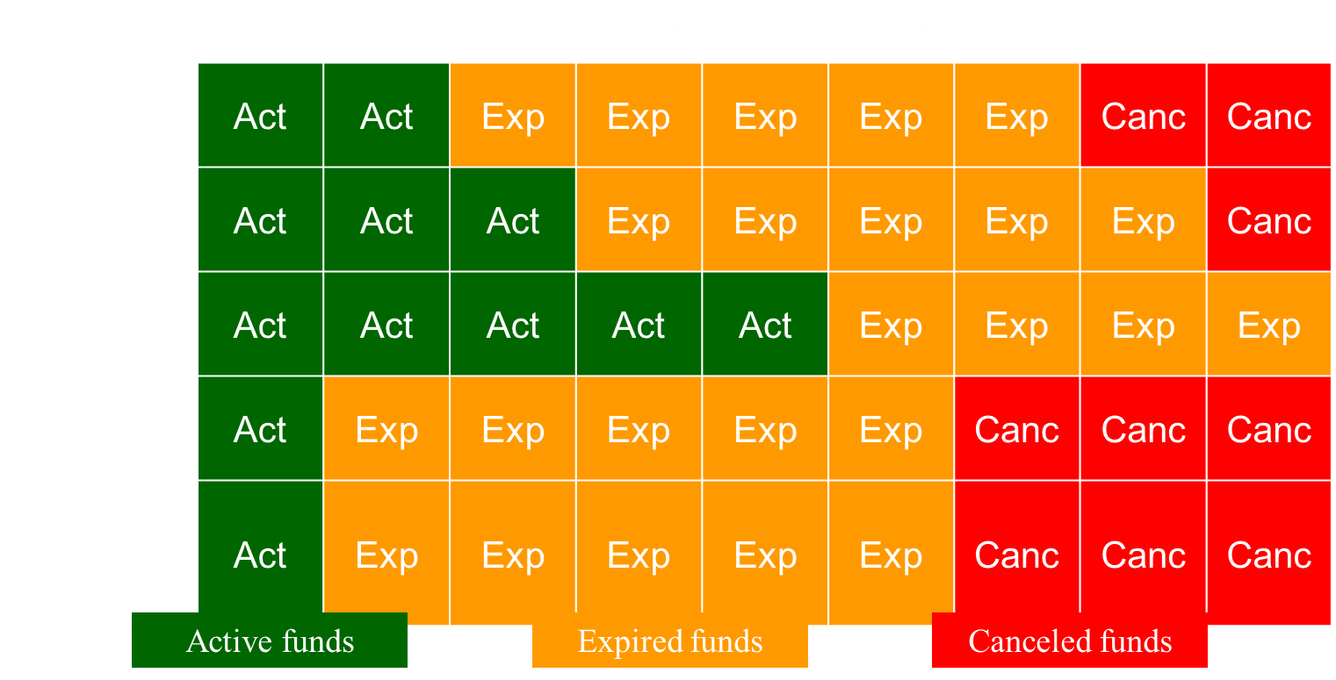
Funding Execution: “Colors” of Money and Lifetime
RDT&E: 3600 Incremental funding 2 year lifetime
Procurement: 30X0 Full funding 3 year lifetime
MILCON: 3300 Full funding 5 year lifetime
O&M - MILPERS: 3400/3500 Annual funding 1 year lifetime
RDT&E: Research Development Test & Evaluation MILCON: Military Construction O&M: Operations & Maintenance
MILPERS: Military personnel

Slide 96
3600 Appropriations FY 15
Source: United States Air Force Agency Financial Report 2015, http://www.dodig.mil/pubs/documents/DODIG-2016-017.pdf
GPS: Global Positioning System SBIRS: Space Based Infrared System AEHF: Advanced Extremely High Frequency

Slide 97

Should Cost

Slide 98
Background on Will-Cost/Should-Cost
Sept 2010: Better Buying Power guidance issued by USD (AT&L)
Objective: to “do more without more,” and obtain “greater efficiency and productivity in defense spending”
One of the 23 directives was to “Drive Productivity Growth through Will-Cost/Should-Cost Management”
June 2011: SAF/FM and SAF/AQ issued memorandum “Implementation of Will-Cost and Should-Cost Management”
Will-cost (WC) estimate: Non-advocate life cycle cost (LCC) estimate to serve as budget baseline
Should-cost (SC) estimate: LCC estimate developed by program office and used as management tool to incentivize performance to targets
“In its space portfolio, the Air Force is tracking should-cost practices that could reduce it programs’ previously-budgeted costs by up to $6 billion.” Air Force Association conference in Orlando, Florida, Dr. William LaPlante, Assistant Secretary of the Air Force for Acquisition. (By Jared Serbu | @jserbuWFED February 18, 2015 10:46 am)
AT&L: Acquisition Technology & Logistics SAF/FM: Air Force Secretariat/Financial Management SAF/AQ: Acquisition

Slide 99
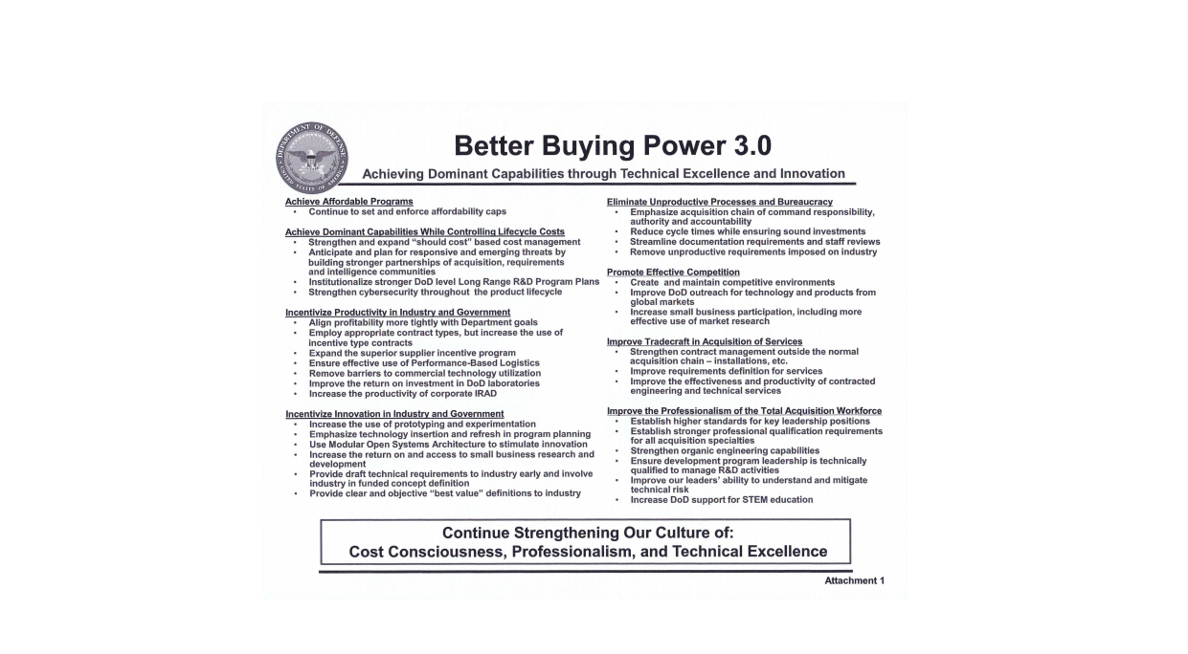
Better Buying Power 3.0 Guidance Roadmap from USD (AT&L)

Slide 100
BBP 2.0
Achieve Affordable Programs | Conducting a program at a cost constrained by the maximum resources the Department can allocate for a capability. These resources include funding, schedule and manpower.
Control Costs Throughout the Product Lifecycle | The ability to understand and control future costs from a program’s inception is critical to achieving affordability requirements.
Incentivize Productivity and Innovation in Industry and Government | Reward contractors for successful supply chain and indirect expense management.
Eliminate Unproductive Processes and Bureaucracy | Unnecessary and low-value added processes and document requirements are a significant drag on acquisition productivity and must be aggressively identified and eliminated.
Promote Effective Competition | Real competition is the single most powerful tool available to the Department to drive productivity.
Improve Tradecraft in Acquisition of Services | The substantial amount of money spent on contract support services demands a management structure to strategically source these goods and services.
Improve the Professionalism of the Total Acquisition Workforce | It is the duty of the acquisition workforce to conduct itself with excellence, responsibility, integrity and accountability.

Slide 101
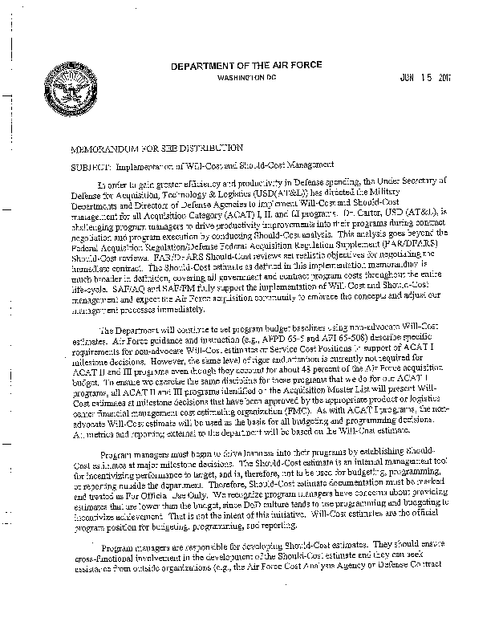
Will-Cost/Should-Cost Implementation Guidance
Applies to ACAT I, II, and III programs
WC & SC estimates required at Milestones, with annual updates
For ACAT I programs, WC estimate will be SCP or ICE
For ACAT II programs, WC estimate will be SBE
Approach selected by SMC to develop SC estimate:
Use WC estimate as base and apply discrete, measurable items and/or specific initiatives for savings against that base
Notes:
SCP – Service Cost Position
ICE – Independent Cost Estimate
SBE – Single Best Estimate

Slide 102
SMC has Developed a Space Portfolio Should-Cost Plan
Memorandum containing prioritized plan for developing SC estimates for Air Force space programs
Signed by General Pawlikowski on 1 August 2011
Update in progress
Requests waivers for selected ACAT I programs, and grants waivers to selected ACAT II programs
Basis for waiver is typically program status– e.g., whether program is post-Milestone C, restructuring, or lacking funds
For remaining programs, memorandum specifies anticipated date for completing SC estimate plans and SC estimates
SMC/FMC and program office must provide SC estimate plan (describing how estimate will be developed) at least 3 months before estimate is due
ACAT: Acquisition category SC: Should Cost SMC/FMC: Staff Cost Shop

Slide 103
Waterfall Chart (Associated with a Program’s Should-Cost Estimate)
Will Cost
Should-Cost
CAPE ICE or SCP (if ACAT I)
or
SBE (if ACAT II or III)
$
TY
For
“FIRESAT”
(Includes LL, NRE, RE, LOOS)
POE Reduction
($)
Schedule Streamlining
(Savings $)
Test Reduction
Most Likely
$ TY
(Savings $)
Management/Scope
Reduction
(Savings $)
Aggressive
$ TY
$ TY
Enterprise Synergy
(Savings $)
$
Escalation
$
LOOS
$
NRE
$
“FIRESAT” RE+LL
CAPE: Cost Assessment & Program Evaluation ICE: Independent Cost Estimate SCP: Service Cost Position
ACAT: Acquisition Category SBE: Single Best Estimate TY: Then Year LL: Long Lead NRE: None Recurring Engineering
RE: Recurring Engineering LOOS: Launch and Orbit Operations Support POE: program Office Estimate
Notes:
Using this to come up with negotiating position
Cost Analysis Requirements Description (CARD)
SCP – Service Cost Position
SBE – Single Best Estimate

Slide 104
Earned Value Management EVM

Slide 105
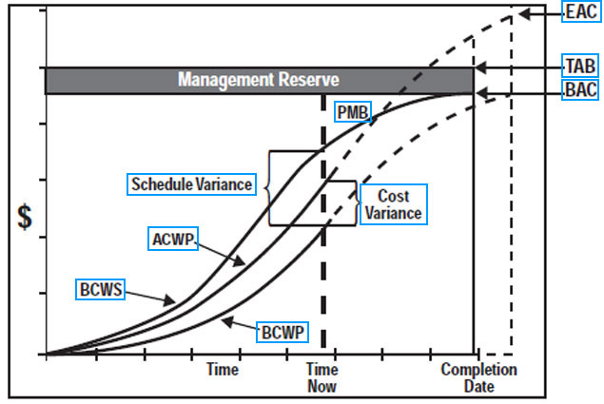
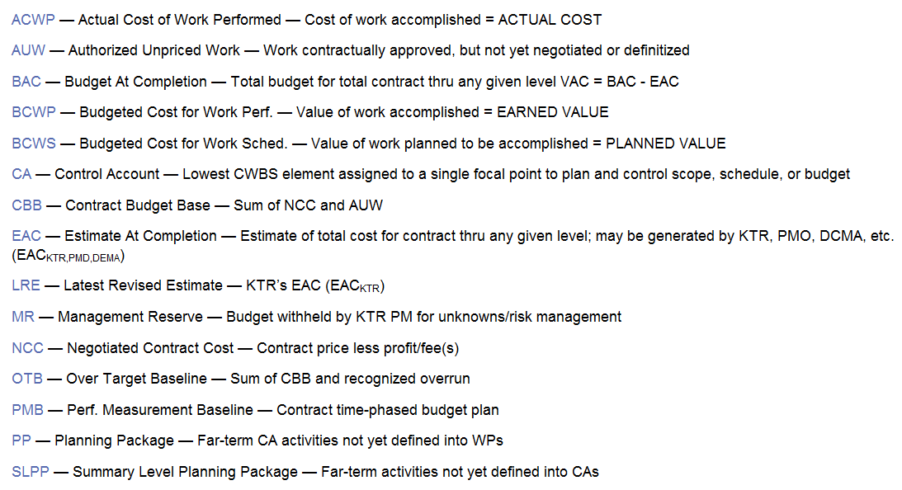
Earned Value Management (EVM)
The means by which the cost, schedule, and technical aspects of a program are integrated to provide complete and objective visibility of program performance.

Slide 106
Earned Value Management

Slide 107
Earned Value Management
35
30
25
20
15
10
5
Primary importance is managing to the value delivered, with respect to the costs incurred.
BCWS
BCWP is performance. When did I provide…to the level of acceptable performance or specification… the deliverable that I agreed to provide?
Cumulative Spending (in $ K)
ACWP
BCWP (Earned Value (EV)
Jan Feb Mar Apr May Jun Jul Aug
Requirement Design Code Test System User
Analysis Implement Acceptance
Notes:
Earned Value focuses on DELIVERABLES.
We introduce the concept of BCWP, or budgeted cost of work performed…represented by the green line.
Let’s place this in the context of a typical software development project. You can see the phases of the project…which are associated with dates….and costs in thousands $K. This is typical.
Instead of a straight line Burn Rate, we also introduce a more realistic S curve that depicts spending money at a low rate during the start of a project; accelerating during execution; and wrapping up the final closeout costs at the end.
[ANIMATION]
BCWP requires us to answer a couple of key questions. In particular:
When did we deliver, and have accepted according to an agreed standard, what we said we planned to deliver?
Answering this question will allow us to compare performance to costs, with respect to our plan.
The red line is still the Actual Cost of Work Performed--actual costs based on timesheets + project overhead + project expenses

Slide 108
Earned Value “Variances”
35
30
25
20
15
10
5
BCWS
Cost Variance =
BCWP – ACWP
15 – 25 = -10
Schedule Variance =
BCWP – BCWS
15 – 20 = -5
Cumulative Spending (in $ K)
ACWP
BCWP
Jan Feb Mar Apr May Jun Jul Aug
Requirement Design Code Test System User
Analysis Implement Acceptance
BCWS: Budgeted Cost of Work Scheduled BCWP: Budgeted Cost of Work Performed ACWP: Actual Cost of Work Performed
Notes:
Let’s put some numbers on the diagram to demonstrate. At the end of the CODE development phase, in APRIL, we budgeted 15K. However, we didn’t actually deliver the code until mid-May. We’re 2 weeks late.
Schedule variance is BCWP-BCWS. Essentially, the date a deliverable is planned for delivery is compared to the date that it is actually delivered. Remember that we are making a mental leap here of converting time to money. So we express being behind schedule as the value of 15K-20K = -5K.
Cost variance by subtracting BCWP-ACWP. In this case BCWP-AWCP is going to be a negative number meaning that….the project is over budget. 15K-25K=-10K
This is simple. Negative numbers are bad. Positive numbers are good.

Slide 109
Earned Value “Indices”
35
30
25
20
15
10
5
BCWS
CPI = BCWP/ACWP
15 / 25 = .60
SPI = BCWP/BCWS
15 / 20 = .75
Cumulative Spending (in $ K)
ACWP
BCWP
Jan Feb Mar Apr May Jun Jul Aug
Requirement Design Code Test System User
Analysis Implement Acceptance
BCWS: Budgeted Cost of Work Scheduled BCWP: Budgeted Cost of Work Performed ACWP: Actual Cost of Work Performed
CPI: Cost Performance Index SPI: Schedule Performance Index
Notes:
CPI and SPI measure the ratio of costs and performance
CPI: is another ratio that compares the BCWP / ACWP. If CPI is 1.0 then total project costs are exactly equal to the value of the deliverables. Over 1.0 is excellent; less than 1.0 is bad. In this case 15/25 = .6 is VERY BAD. It means that we are delivering only 60% of value compared to the costs. Or we are about 40% over budget
SPI: and we can do a similar thing for schedule by BCWP/ BCWS. 1.0 is perfect. Less than 1.0 is bad. In this case 15/20 = .75 is BAD.
It means that we are about 25% behind schedule.
By comparison, the old fashioned, conventional, cost-based project accounting would tell you that our baseline was 20K to this point and our ACWP is 25K at this point…therefore we’re only 5K over budget; or only 20% over budget; or 80% on track…should be a “B” in high school. You would have a false confidence even as your project was going down the tubes. Measuring CPI and SPI is far more useful than simply having a “burn rate”.

Slide 110
Estimate at Completion (EAC)?
Over
Budget
EAC
Management Reserve
PMB
P
R
O
J
E
C
T
E
D
S
L
I
P
P
A
G
E
Schedule Variance_{C}
$
Cost Variance_{C}
BCWS
ACWP
BCWP
0
1
2
3
4
5
YEARS
Time
Now
Completion
BCWS: Budgeted Cost of Work Scheduled BCWP: Budgeted Cost of Work Performed ACWP: Actual Cost of Work Performed
EAC: Estimate at Complete PMB: Program Management Baseline

Slide 111
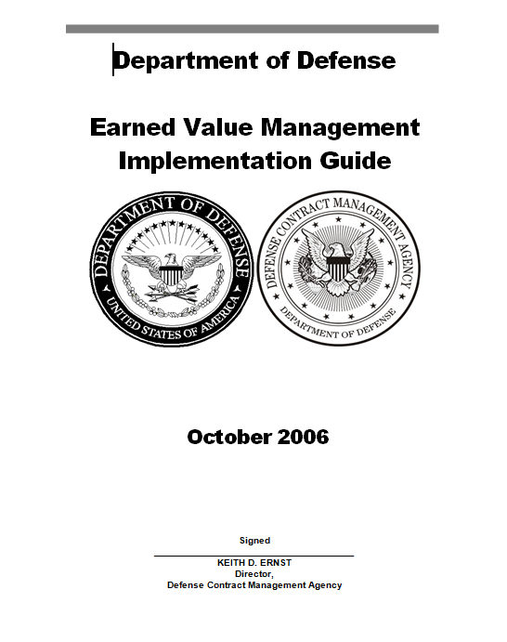
Earned Value Management(EVM)
An Earned Value Management System (EVMS) can be defined as an integrated management system and its related sub-systems, which allow for:
planning all work scope for the program to completion
assignment of authority and responsibility at the work performance level
integration of the cost, schedule, and technical aspects of the work into a detailed baseline plan
See the DAU Program Manager’s e-Tool Kit (earned value)
https://acc.dau.mil/CommunityBrowser.aspx?id=294488&lang=en-US

Slide 112
EVM Defined
EVM is:
a management tool that integrates work scope with schedule and budget
performance measurement
how am I doing against my performance management baseline?
performance management
what do I need to do to bring the project in on cost and schedule?
first used by DoD (1967)
EVM is not:
a particular system dictated by the government
an accounting system
cost history

Slide 113
EVM Roles & Responsibilities
Program Team Role
Ensures government properly contracts for EVM
Leads Integrated Baseline Reviews
Uses EV as a management tool
Financial/Cost Analyst’s Responsibilities
Understands EVM guidance, process and all players
Assists in ensuring that solicitations include required EVM Clauses/CDRL items
Works with other functionals (e.g. engineers, logisticians) to get their assessment of variance explanations and corrective actions
Provides comprehensive, integrated written monthly analysis to program manager
Based on analysis, makes appropriate adjustments to government cost estimates and budgets, etc.
Notes:
DCMA – Defense Contract Management Agency

Slide 114
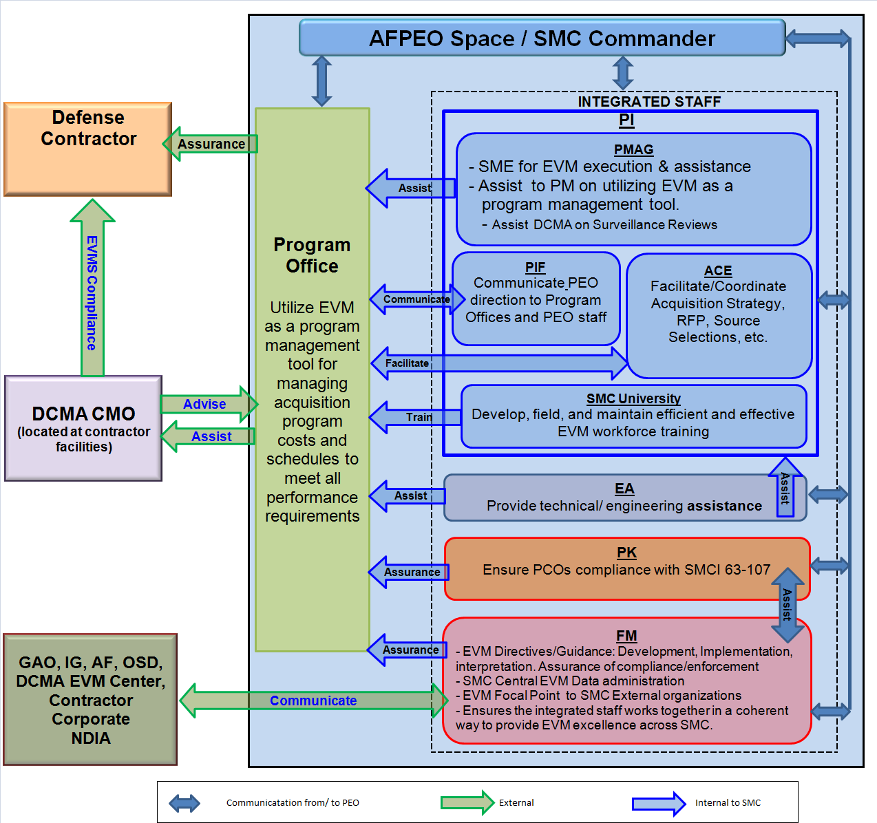

Slide 115

Benefits of EVMS
Early identification of trends and problems
Accurate picture of project status
Cost, schedule, technical and risk
Segregation of schedule and cost variances
Basis for course correction
Projection of final costs
Project control by the team
Notes:
4

Slide 116
EVM Reports
Contract Performance Report (CPR), Now the Integrated Program Management Report (IPMR)
Integrated Master Schedule (IMS)
Contract Funds Status Report

Slide 117
Integrated Program Management Report (IPMR)
Purpose
Provides program team with information on progress on cost, schedule and technical performance on specific contract
Five Formats
Format 1 – Work Breakdown Structure
Format 2 – Organizational Categories (Functional)
Format 3 – Baseline
Format 4 – Staffing
Format 5 – Explanations and Problem Analysis

Slide 118
What is an IBR? Integrated Baseline Review
Evaluation of performance measurement baseline
Assessment of baseline realism
Identification of inherent risks
Joint assessment by government &
contractor
Informal discussions
Continuous
Part of integrated project management (Govt & Ktr)
Should be seen as "Process"
Not a stand alone "Event"
Technical
Baseline
Schedule
Cost
Govt: Government Ktr: Contractor
Notes:
6

Slide 119
5 IBR Objectives
Assess the degree to which:
Technical scope of work is fully included and is consistent with authorizing documents
Project schedule key milestones are identified and reflect a logical flow to accomplish technical work scope
Resources (budgets, facilities, personnel, skills, etc.) are available and are adequate for the assigned tasks
Tasks are planned and can be measured objectively relative to the technical progress
Management processes support successful execution of the project
IBR: Integrated Baseline Review
Notes:
9

Slide 120
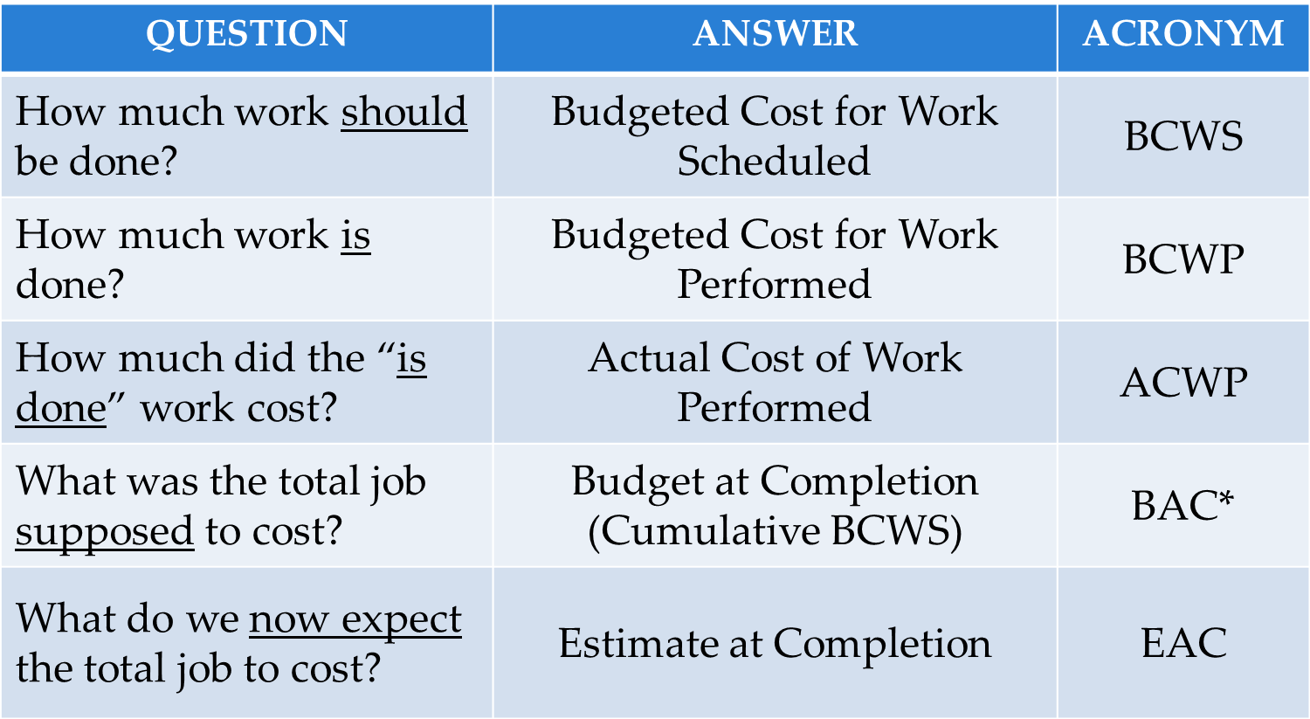
EVM Performance Measurement Answers 5 Basic Questions

Slide 121
Rules of Thumb
EVM performance must be looked at on a contract-by-contract basis. Metrics combining multiple contract variances mask true performance
Cost Performance Indices (CPI) is a good predictor of best case final cost after contract is 20% complete
Schedule performance is the leading indicator
Schedule performance should not be used to calculate EAC’s after the program is 50% complete
After a decision to rebaseline, it takes at least 8 months to receive meaningful performance measures
Easy rule of thumb:
negative value = BAD positive value = GOOD
index < 1.0 = BAD index > 1.0 = GOOD

Slide 122
Summary
Earned Value is an effective management tool that ties work scope, schedule, and cost performance together
To realize full benefits, Earned Value requires
High confidence, stable, performance baseline
Teamwork among contractor, program office and Defense Contract Management Agency (DCMA)
Utilization in program management process
Visibility at senior management reviews

Slide 123
Management Reporting

Slide 124
Management Reporting -- SMART
Air Force acquisition programs report their metrics in (the) System Metric and Reporting Tool (SMART)
A collaborative web-based application designed to assist program managers and acquisition professionals with day-to-day tasks of defining, managing, and reporting program health and status throughout a program's life cycle
Provides near real time visibility to upper-level management by providing authoritative program information that adheres to OSD and SAF/AQ policy and business rules
Source of the AF Program Master List and generates a consistent reporting capability for both the Defense Acquisition Executive Summary (DAES) to the OSD-level Defense Acquisition Management Information Retrieval (DAMIR) system and the Monthly Acquisition Report (MAR) to SAF/AQX.
OSD: Office of the Secretary of Defense SAF/AQ: Air Force Secretariat/Acquisition SAF/AQX: Acquisition Integration

Slide 125
Management Reporting -- CCaR
Comprehensive Cost and Requirements (CCaR) is the tool the Air Force uses to document requirements, execute funds (in GAFS) and report implementation - provides current execution data for all programs here at SMC
CCaR standardizes our processes to:
Manage program requirements
Execute program funds
Track and report execution of the requirements.
Provide organizations greater flexibility and control over their requirements and budgets
Executive CCaR is a derivative of CCaR and is the tool used by SAF, on their desktop, to review program execution on a monthly basis
GAFS: Air Force Accounting System SMC: Space and Missile Systems Center SAF: Air Force Secretariat

Slide 126
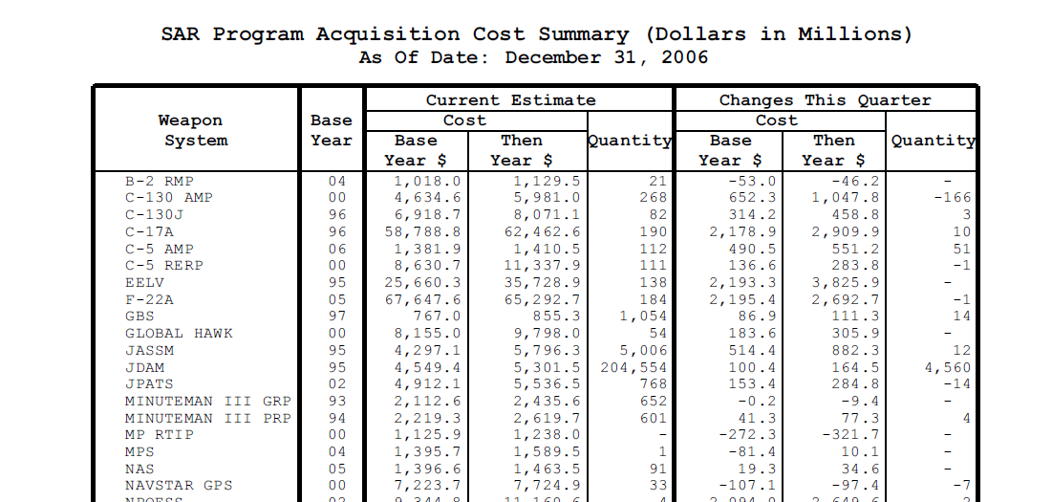

Management Reporting - SAR
Selected Acquisition Reports (SARs)
Summarize the latest estimates of cost, schedule, and performance status of ACAT 1 programs
Measure program against Approved Program Baseline
Prepared annually in conjunction with the President's budget
ACAT: Acquisition Category

Slide 127

Management Reporting - MAR
Management Acquisition Report - MAR
Program manager’s key reporting and status tool to SAF/AQX (Acquisition Integration)
Provides critical overview and status of key element required for management and delivery
Used as early warning for Defense Acquisition Executive Summary (DAES)
BE SURE TO READ THESE!

Slide 128

Management Reporting - DAES
Defense Acquisition Executive Summary (DAES)
Required for programs of $60M in research, and/or $250M in procurement
Includes contract info and descriptive data
Requires the program manager’s current performance Estimate At Complete (EAC)
Management quarterly reporting tool

Slide 129



Management Reporting – SPR/IBR
SAF/AQX and SAF/FMBI jointly conducts a combined Spring Program Review (SPR) and Investment Budget Review (IBR) of our acquisition programs to ensure programs are appropriately funded, prepared for OSD’s mid-year execution review and to ensure programs’ FYDP requirements are understood going into the Program Objective Memorandum (POM) process
The SPR/IBR provides an opportunity to share critical information regarding the health of our programs and to look for improvement opportunities.

Slide 130
Cost Estimates

Slide 131
Key Cost Estimating Terms
Life Cycle Cost Estimate
“Cradle-to-Grave” estimate of system cost
Includes R&D, production, O&S, disposal
Point Estimate
An estimate which does not have any adjustment for uncertainty or risk
Non-Recurring
Refers to “one-time” costs not of a repetitive nature
Engineering design, installation of test equipment, construction, tooling
Recurring
Refers to those costs that occur again and again from one period to the next or at specific intervals
Engineering support, materials, labor

Slide 132

Phases Covered by Life Cycle Cost Estimate (LCCE)

Slide 133
Pre-Systems Acquisition Costs
Costs incurred prior to Milestone B
Governed by Initial Capabilities Document (ICD)
Material Solution Analysis
Analysis of Alternatives (AoA)
Technology Development
Development of a Preliminary Design
Risk Reduction
Preparation of Capabilities Development Document (CDD)

Slide 134
Systems Acquisition Costs
Governed by
Capability Development Document (CDD) and
Capability Production Document (CPD)
Engineering and Manufacturing Development (EMD)
Integrated System Design
Analysis of Reliability, Maintainability, Producibility
Prototyping
Testing
Production of system

Slide 135
Sustainment Costs
Occur as weapon system is deployed
O&S Cost Elements (from 2007 OSD O&S Cost Estimating Guide)
1.0 Unit Level Manpower
2.0 Unit Operations
3.0 Maintenance
4.0 Sustaining Support
5.0 Continuing System Improvements
6.0 Indirect Support
O&S: Operations and Sustainment

Slide 136
Key Types of LCCEs for SMC Programs
Program Office Estimate (POE) - cost estimate done at the program office
Independent Cost Assessment (ICA) - independent cost estimate developed for a program by SMC/FMC
Single Best Estimate (SBE) - cost estimate developed by the program office and SMC/FMC
Non-Advocate Cost Assessment (NACA) – independent cost estimate developed by AFCAA
A Component Cost Estimate
Service Cost Position (SCP) - the Air Force’s single, agreed upon cost position for a program, developed by the program office, SMC/FMC and AFCAA
A Component Cost Position
Independent Cost Estimate (ICE) – estimate prepared by an organization not in the program office’s acquisition chain of command
AFCAA: Air Force Cost Analysis Agency FMC: Cost Shop

Slide 137
Steps in the Cost Estimating Process
STEP 1: Define program and scope of
estimate
STEP 2: Collect and adjust data
STEP 3: Formulate estimate
STEP 4: Document and present results

Slide 138
Step 1. Define Program and Scope of Estimate
Define program to be estimated
Work Breakdown Structure (WBS)
MIL-STD 881C provides guidance and applies to Pre-Systems Acquisition and Systems Acquisition Phases
OSD 2007 O&S Cost Estimating Guide provides guidance and applies to Sustainment Phase
FMC recently developed O&S guide for internal use
Technical description of end item
Integrated Master Schedule
Production Buy Schedule
Contractual relationships
Maintenance Concept
Basing Concept
Stakeholders
Ground rules/Assumptions

Slide 139
Example: Notional WBS for a Space System
1.0 SKYLARK Communication System
1.1 Systems Engineering, Integration and Test, and Program Management (SEIT/PM)
1.1.1 Systems Engineering
1.1.2 Assembly, Integration, & Test
1.1.3 Program Management
1.1.4 Support Equipment
1.2 Space Vehicle 1
1.2.1 SEIT/PM and Support Equipment
1.2.2 Bus
1.2.3 Space Vehicle Storage
1.2.4 Launch Operations
1.2.5 Mission Operations Support
1.3 Ground Operations and Processing Center 1
1.4 Ground Terminal (GT)1
1.4.1 Antenna 1
1.4.2 Monitor & Control hardware
1.4.3 GT Software

Slide 140
Step 1. Define Program and Scope of Estimate (Cont’d)
Cost Analysis Requirements Document (CARD)
Required for all ACAT I Program Milestones
Provides
System description
Technical, programmatic and schedule information
Information on program risk
Creates a common baseline for various organizations preparing estimates
Manpower Estimate Report (MER)
Program document (not a cost document) used by cost teams

Slide 141
Step 2. Collect and Adjust Data
Data Collection
Initial research
What data are available
Analysts typically collect historical data from other programs
Best cost tools/models to use with data
Iterative Process
Data/tools may not end up being suitable
Alternative data/methods may be needed
Examples of data sources
Prime contractor and subcontractors
Government test centers
Other government team members ( e.g., systems engineer, test manager, contracting officer, logistician)
Army, Navy, & other Air Force programs
Defense Contract Management Agency
Defense Cost and Resource Center (DCARC)

Slide 142
Step 2. Collect and Adjust Data
Data Normalization
Definition: Adjusting specific pieces of data to make the data set homogenous
Objective:
To make data as consistent as possible to allow valid comparisons and projections
To enable use of all credible data
Most common normalizations:
Inflation adjustment
Quantity (e.g., compare costs at equivalent unit)
Differences in contractor accounting methods

Slide 143
Step 3. Formulate Estimate
Four major estimating techniques
Parametric
Analogy
Engineering estimate (also called “bottoms-up” or “grassroots” technique)
Expert Opinion (Delphi)
Other considerations when formulating estimates
Phasing
Risk

Slide 144




Step 3. Formulate Estimate:
Timing of Different Estimating Techniques
MILESTONES
A B C
TECHNOLOGY DEVELOPMENT ENG/MFG DEVEL PRODUCTION/DEPLOYMENT/SUSTAINMENT
PARAMETRIC
(MATHEMATICAL)
ANALOGY
(COMPARISON)
ENGINEERING (BU)
(ACTUAL HOURS)
ARTIST CONCEPT TECH DEMO TEST SATELLITE PRODUCTION SATELLITE
DSCS III in Acoustic Chamber
DSCS III Sat Testing Lockheed Photo
DSCS: Defense Satellite Communications System BU: Build Up

Slide 145
Step 3. Formulate Estimate:
Parametric Technique
TECHNOLOGY DEVELOPMENT ENG/MFG DEVEL PRODUCTION/DEPLOYMENT/SUSTAINMENT
An estimating technique that involves using regression or other statistical methods and historical data to develop Cost Estimating Relationships (CERs). (In many cases, the technique involves using existing CERs, rather than developing new ones.)
Independent variables in the CER are usually the main cost drivers.
Example:
TT&C/C&DH (Telemetry, Tracking, & Command; Command & Data Handling System)
Y = 4061.72*(X₁^{0.622}), where X1 = C&DH subsystem mass
and Y = TT&C/C&DH subsystem cost
PARAMETRIC (MATHEMATICAL)

Slide 146


Step 3. Formulate Estimate:
Analogy Technique
TECHNOLOGY DEVELOPMENT ENG/MFG DEVEL PRODUCTION/DEPLOYMENT/SUSTAINMENT
Analogy
An estimating technique that involves using actual historical costs of a similar item, with adjustments for differences in technical or physical characteristics, to estimate the cost of a new item
DSCS I
MILSTAR

Slide 147
Step 3. Formulate Estimate:
Engineering or “Bottoms-Up” Estimate Technique
TECHNOLOGY DEVELOPMENT ENG/MFG DEVEL PRODUCTION/DEPLOYMENT/SUSTAINMENT
Engineering
Estimate
(ACTUAL HOURS)
An estimating technique that entails estimating labor, material, and other costs associated with lower-level components (e.g., parts or assemblies) in a system’s WBS
The discrete cost elements are aggregated to get the overall system estimate

Slide 148
Step 3. Formulate Estimate:
Expert Opinion
Delphi Method
Subject matter experts provide individual / anonymous answers to set of questions
The results are summarized and sent back for coordination/comment
Final range of opinions is documented

Slide 149
Step 3. Formulate Estimate:
Other Considerations
Phasing
Proper phasing critical to successful program
Basis for budget submissions
Too many dollars in fiscal year will put funding at risk due to poor budget execution
Too few dollars in a fiscal year will negatively impact program execution
Starting with a point estimate, spread the Base Year dollars across fiscal years; then inflate to Then Year dollars.
Uncertainty/risk analysis
FY11 National Defense Authorization Act requires identifying confidence level of estimates for MDAPs
Point estimates should be adjusted to include risk

Slide 150
Ten Commandments of Congressional Interaction
1. Thou shalt be consistent
2. Thou shalt support the President’s Budget
3. Thou shalt not beg for additional money
4. Thou shalt be timely
5. Thou shalt be clear, accurate, and truthful
6. Thou shalt not use jargon or geeky technical terms
7. Thou shalt follow the format
8. Thou shalt contact Congress through legislative liaisons
9. Thou shalt coordinate
10. Thou shalt keep the leadership informed

Slide 151

Perspective
“You cannot escape the responsibility of tomorrow by evading it today”
http://www.quotationspage.com/quotes/Abraham_Lincoln/

Slide 152
MODULE SEVEN
Planning, Programming, Budgeting and Execution
(PPBE)

Slide 153

Space and Missile Systems Center
Deliver resilient and affordable space capabilities for the nation
Introduction to PPBE
A PPBE Process Overview
Providing the Technological Edge to our Nation’s Warfighters and Allies from the High Frontier
PPBE: Planning, Programming, Budgeting and Execution

Slide 154
PPBE Planning, Programming, Budgeting and Execution
Department of Defense resource allocation system
Framework to decide future capabilities and provides an opportunity to reexamine prior decision in light of evolving threats, economic conditions, and security concerns
Iterative process consisting of four interrelated and overlapping phases
Each of these phases contributes to producing a plan, a program and finally a budget that provides the best mix of forces, equipment and support within fiscal constraints
Notes:
As you can imagine, any organization the size of the Department of Defense will have a formal resource allocation process. The is exactly what the PPBE is, the Planning, Programming, Budgeting, and Execution system. There are four overlapping stages or phases in this system and you will be working on more than one of them at the same time. We will first look at the timing of the major events.

Slide 155
Phases
PPBE Planning, Programming, Budgeting and Execution
Here are the eight phases in the development and execution of the DOD budget…
PROCESS
INPUT
P
P
B
E
PROCESS
OUTPUT
CONNECTOR
CONNECTOR
Vision &
Strategy
Planning
Prioritization
Programming
Budgeting
Enactment
Execution
Vision Enabled
Capabilities, Resource Analysis & Metrics
Feedback

Slide 156
Overlapping PPBE Process
OCT | NOV | DEC
CY 2015
2014
JAN | FEB | MAR | APR | MAY | JUN | JUL | AUG | SEP
FY 18-37
PLANNING
GDF
JPG
NDS
IPL
NMS
AF Guidance
FY 17-21
PROGRAMMING
AFC
BES
Build
4-Star Meeting
AFB
Panel Prep
SecAF
CSAF
1st AFG
2nd AFG
PR/BR
Baseline
Extension
BES to OSD
MAJCOM 1- “n”
POM
FY 16
BUDGETING
Revise Budget
Committee Deliberations
Budget
Enacted
RMDs
Hearings & Staffer Days
PB to Congress
(Previously PDM/PBD)
IBR
OBR
Initial Distribution
Planning
FY 15
EXECUTION
Initial Distribution
Execution
Review
Mid Year
Review
Execution
Review
S u p p l e m e n t a l ( s)
F Y C l o s e o u t
PPBE: Planning, Programming, Budgeting & Execution CY: Calendar Year GDF: Guidance for Development of the Force
JPG: Joint Planning Guidance NDS: National Defense Strategy IPL: Integrated Priority List NMS: National Military Strategy
AF: Air Force AFG: Air Force Guidance AFB: Air Force Board AFC: Air Force Council
SECAF: Secretary of the Air Force CSAF Chief of Staff Air Force BES: Budget Estimate Submission
OSD: Office of the Secretary of Defense POM: Program Objective Memorandum PR/BR: Program Review/Budget Review
RMD: Resource Management Decision PDM/PBD: Program Decision Memorandum/Program Budget Decision PB: President’s Budget
IBR/OBR: Investment Budget Review/Organizational Budget Review
Notes:
We are not going to go over this chart in detail. I just want to show how the process phases are overlapped. Planning looks way into the future. Each phase after that gets a little more near term. Programming is for the next 5 years or so, budgeting is for the next fiscal year, and execution is funding that is currently in hand. We will talk about each phase. The next chart has a list of all the acronyms on this chart.
PPBE – Planning, Programming, Budgeting, Execution
NDS – National Defense Strategy
IPL – Integrated Priority List
NMS – National Military Strategy
GDF – Guidance for the Development of the Force
JPG – Joint Programming Guidance
MAJCOM – Major Command
AFG – Air Force Group
AFB – Air Force Board
AFC – Air Force Council
SecAF – Secretary of the Air Force
CSAF – Chief of Staff of the Air Force
POM – Program Objective Memorandum
BES – Budget Estimate Submission
PBR – Program Budget Review
OSD – Office of the Secretary of Defense
PR – Program Review
BR – Budget Review
RMD – Resource Management Decision
PB – President’s Budget
IBR – Investment Budget Review
OBR – Operating Budget Review

Slide 157
PPBE Planning, Programming, Budgeting and Execution
The PPBE process provides a structure allowing Service chiefs to link resources to desired capability and missions in an analytically rigorous manner
DoD Budget is ~$540B annually; AF Budget is ~$150B annually
PPBE provides a structured method to build the budget
Planning
National Security Strategy → National Military Strategy → DoD Capabilities
A process to
Set direction for the organization
Evaluate courses of action
Provide guidance to allocate resources
SAF/FM, SAF/AQ and AF/A8P focus on the Programming, Budgeting and Execution phases of PPBE

Slide 158
Programming Building the AF POM
The first step is to build the Air Force Program Objective Memorandum (POM)
Determine Capabilities needed as outlined in Planning Guidance
Apply resources to support/provide these capabilities
New POM every year
No more on-year, off-year
Each budget covers a 5-year period
POM submissions come in from AFSPC
MAJCOMs develop their POM submission
PMs work with AFSPC PEM on POM inputs
SMC/PIF works closely with AFSPC/A8 “Engine Room”
PM Action: Work with AFSPC to develop acquisition program POM input & coordinate with SMC/PIF for AFPEO/SP Review/Approval
Notes:
Resources include manpower, physical equipment and funds

Slide 159
Building a POM
Identify the deficiency / requirement
Develop a solution
New Capability
Upgrade
Form, Fit & Function
Cost solution
Brief AFSPC A-3/A-5 Counterpart
Prepare / Coordinate RAPIDS
SMC (PIF / CD / CV / CC)
AFSPC (A-3 / A-5)
Began Formal Briefing / Justification process
Capabilities Based Assessment (CBA)
POM: Program Objective Memorandum AFSPC: Air Force Space Command
RAPIDS: Resource Allocation Program Integration Documentation SMC: Space and Missile Systems Center
AFSPC: Air Force Space Command
Notes:
JCIDS Manual 19 Jan 2012
The fundamental goal of each approach is to derive and refine capability requirements – either organically or leveraged through the Joint force – necessary to accomplish their assigned functions, roles, missions, and operations. Primary outputs include:
(1) description of the mission and military problem being assessed.
(2) identification and assessment of prior CBAs, studies, and other analytical products applicable to the area of interest.
(3) identification of the tasks to be completed to meet the mission objectives.
(4) identification of the capability requirements within one or more of the JCAs, described in terms of the tasks, performance, and conditions.
(5) assessment of capability gaps between the identified capability requirements and current or programmed force capabilities.
(6) assessment of operational risks associated with each capability gap if not addressed.
(7) evaluation of possible non-materiel and materiel approaches to satisfy part or all of the capability requirements and close or mitigate the associated capability gaps.
(8) recommendation for the most appropriate approach to be taken to close or mitigate capability gaps and reduce operational risk.
c. While Sponsor activities may examine various aspects of their capability requirements in significant levels of detail, the key for JCIDS is to establish the high level operational capabilities which are required, place them in the context of overall strategic and operational goals, and be able to compare them to legacy capability solutions, if any, in order to evaluate the most appropriate path forward to satisfy the capability requirements and reduce or eliminate any associated capability gaps.
d. Identified capability requirements must be traceable to approved Joint Concepts developed in accordance with reference g, or a Concept of Operations (CONOPS) developed in conjunction with an approved operation plan (OPLAN), concept plan (CONPLAN), Integrated Security Constructs (ISCs) which are part of the DOD Analytic Baseline developed in accordance with references h and i, and/or other JROC approved guidance. Traceability to the CRA should also be provided when applicable. Efforts identifying capability requirements for Information Systems (IS) should use the existing DOD Information Enterprise Architecture and related solution architectures in accordance with reference j. CONOPS must be endorsed by the JROC, a CCMD, a Service, or a defense
agency. These documents form the basis for validating capability requirements and associated gaps and risks, and support any recommendations for development and deployment of new or improved capability solutions.
e. Each approach for identifying capability requirements should not presuppose a specific capability solution or end item, but provide data related to forms and functions of potential solutions to support the development of JCIDS documents. The final recommendations should include a focused and concise summary of the justification for the proposed action.
f. Each approach must identify and build upon any previous CBAs, studies, and other analytical products applicable to the area of interest. The intent is to avoid any unnecessary repetition of prior efforts, and provide
continuity between analyses for reviewers and decision makers. This does not preclude the Sponsoring organization from applying different context or different assumptions, as appropriate for the approach being pursued.
g. Due to the wide array of issues that may be considered, the breadth and depth of each approach must be tailored to suit the issue. The approach must be sufficient to develop coherent and well-supported recommendations, which the validation authority will then use to validate the capability requirements and associated capability gaps to support possible follow-on actions.

Slide 160
Programming A New Vocabulary
Baseline changes are characterized by three terms:
Disconnects (sometimes referred to as a “D”)
Approved programs that require additional resources to perform their already-approved mission
Initiatives (sometimes referred to as an “I”)
Things competing for resources for the first time (New Start)
Or approved programs that require additional resources to expand their mission (add a SBIRS GEO SV)
Offsets (sometimes referred to as an “O”)
Those programs that will relinquish their resources to fund another, higher priority program
D + I = O (it’s really O = D + I)
Without increasing fiscal guidance, the AF can fund only as many disconnects and initiatives as it has offsets to act as bill payers
SBIRS: Space Based Infrared System GEO: Geostationary Earth Orbit SV: Space Vehicle

Slide 161
Programming The POM – Wrapping it up
Final Approval of the POM from SECAF/CSAF
AF/A8PE and SAF/FMBP “The Engine Room” build program guidance
The final balanced position
Includes all “YES” options
SAF/FMB appropriation managers upload changes into ABIDES
The database will lock with the new POM position loaded
Electronic push of POM position to OSD
Approximately 30 days (or less) to finalize J-books
Once we push the POM to OSD the decisions are out of our hands
PM Action: Work with PEM to validate data in ABIDES. It is the OFFICIAL position & determines how funds are loaded in your R-Docs and P-Docs!

Slide 162
Programming The Program Budget Review
Once the POM is submitted to OSD at the end of July we enter the Program Budget Review (PBR) phase
Any changes made to the “POM” must be approved by OSD
“OSD and OMB Hearings” to review POM submission
PEM briefs the OSD Comptroller and OMB analysts
Similar to Staffer Day Briefings
Review the POM position, cost estimates, Congressional action
OSD Issue Teams are formed
Review recommended changes to the POM submission
Cross Department review to balance capabilities and resources
Air Force forms issue teams to mirror OSD issue teams
To develop the Air Force Position on OSD issues
Our Position is ALWAYS to support the Air Force POM
POM: Program Objective Memorandum OSD: Office of the Secretary of Defense OMB: Office of Management and Budget
PEM: Program Element Monitor

Slide 163
Programming The Program Budget Review
OSD analysis conducted in two categories
Program Issues
More strategic in nature
Did we follow the planning guidance? Are there redundancies across the services?
Budget issues
More budget and fiscal in nature
Did we fully fund acquisition programs? Is there a new cost estimate? Are we under-executing?
OSD directed changes are called Resource Management Decisions (RMDs)
Several multi-part RMDs issued each cycle
Contains Program and Budget Issues, Overseas Contingency Operation (OCO) and “Inflation”
Changes uploaded by SAF/FMBI into ABIDES – Database locks
OSD: Office of the Secretary of Defense SAF: Air Force Secretariat ABIDES: Automated Budget Interactive Data Environment System

Slide 164
Programming The Program Budget Review
Draft RMDs issued for comment from the Services
48 hour turn-around on draft RMDs
Substantive, impactful and meaningful impact statements
Air Force simultaneously building a “Warchest”
RMDs may require Air Force to fund an activity – these bills are paid for from the Warchest
Even if your program was not an issue– it may be an offset
Final RMD issued from OSD
OSD considers all “reclamas” and comes to a final decision
Changes must be made in the ABIDES database
Finalize J-books for PB submission to Congress
PM Action: Work with PEM to validate data in ABIDES. It’s the OFFICIAL position & determines how funds are loaded in your R-Docs and P-Docs and is basis for receiving appropriations!
RMD: Resource Management Decision OSD: Office of the Secretary of Defense
ABIDES: Automated Budget Interactive Data Environment System PB: President’s Budget

Slide 165

“Warchest Drills”

Slide 166

Budgeting The Appropriation Process
Constitution of the United States of America
Article I – Legislative Branch
Section 9 “No money shall be drawn from the Treasury, but in Consequence of Appropriations made by Law; and a regular Statement and Account of Receipts and Expenditures of all public Money shall be published from time to time.”
1974 Congressional Budget Act
Requires that by the first Monday in February, the President submit to Congress the proposed budget for the next fiscal year.

Slide 167
Budgeting Budget Documentation - What is it?
Budget request is submitted to Congress on 1st Monday in February of each year
Budget Justification Documentation is the official record of the department’s budget request
Also known as J-Books – collective description of the justification books
R-Docs for the RDT&E request
P-Docs for the Procurement request
Challenge to the program offices – Docs are typically written 2-3 months prior to submission which is 8 or more months before it would be appropriated for work that could take place 2-3 years in the future…
PM Action: Write Quality, Descriptive, Credible Budget Documentation – Work with your PEM & follow the guidance
RDT&E: Research Development Test & Evaluation PM: Program Manager PEM: Program Element Monitor

Slide 168
Purpose of Documentation
Communication documents provide narrative details about each budget line item and explains how the services plan to execute their investment programs
Fully understood/supported budget requests used throughout programming, budgeting, and execution phases
Note: Must be written to Air Force budget position – no whining or internal remarks
This is NOT a way to increase funding for programs—that is thru POM process
The DoD Financial Management Regulation 7000.14R requires the services’ documentation at least twice per year :
PBR: OSD comptroller, PA&E, and policy offices review program documentation and prepare RMDs -- OSD and OMB are the customers
PB: Congress members/staffers use to prepare authorization & appropriation marks
PB Documentation represents AF “contract” with Congress (as modified by congressional authorization and appropriation marks)
All transactions, including reprogrammings and reallocations, will be evaluated against PB documentation to identify new start efforts
Only PB cycle budget documentation submittals go to Congress
PBR cycle documentation is internal to DoD
PB is posted to the web for Congress, press and public access

Slide 169
What will OSD and Congress do with J-Book?
Validate/invalidate it – with all available data sources
What sources are available to OSD and Congress?
Selected Acquisition Report (SAR) / Defense Acquisition Executive Summary (DAES) / Unit Cost Reports (UCRs)
Monthly Acquisition Report (MAR)
Independent Program Assessment (IPA) / Program Management Review (PMR) / Program Reviews
Briefings/info provided to Issue Teams
Staffer Day Briefings (Do you have yours from SAF/AQS?)
Contractor visits (Do your contractors always support the AF position?)
Leadership testimony (Do you have what’s been said regarding your programs?)
If inconsistent information – Will OSD & Congress give you the higher amount or the lower amount…????

Slide 170


Slide 171
Budgeting What is Congress Saying?
The Air Force continues to get Congressional Language on the quality of our budget documentation
SAC-D:
Several programs included in the request do not present sufficient justification to warrant funding
Unfortunately, the Committee must also note that in recent years discipline in Defense budgeting has been lacking.
The Committee remains frustrated by the lack of proper control in the Defense budget process
HAC-D:
The Department continues to fully fund cost increases and schedule slips of programs instead of considering lower cost alternatives.

Slide 172
Budgeting So what is the impact of poor P- & R- Series?
Loss of Air Force spending power!!!!
Between Jun 09 and July 10 the Air Force Investment accounts lost the ability to use $3,653M
Loss of Credibility!!!!
No confidence in our program plans combined with our past performance (expiring funds)—it all works against us
Quotes from Congressional Language as to why:
AF identified excess | Low execution
Request ahead of need | Program reduction
Pricing adjustment | Program restructure
Unjustified program | Program under-execution
Excess funding | Contract/Program delay
PM Action: Spend time on your P- & R- Series and developing executable and realistic (not hopeful) program plans

Slide 173
Budgeting – Congressional Enactment A Bill Becomes Law: The Process for Defense Bills
HASC
House
House
Authorization
House
and
Senate
Pres
SASC
Senate
Senate
PB
Full
Committee
Mark
Subcommittee
Mark
Floor Vote
(Amendments)
Conference
Committee
Floor
Vote
President
Signs/Vetoes
HAC
House
House
HAC-D
House
and
Senate
Pres
Appropriations
SAC
Senate
Senate
SAC-D
HASC: House Armed Services Committee SASC: Senate Armed Services Committee HAC-D: House Appropriations Committee-Defense
SAC-D: Senate Appropriations Committee- Defense PB: President's Budget

Slide 174
Congressional Staff Committee Staffer Responsibilities
Draft committee marks
Draft bill language
Write committee reports
Write hearing questions
Advise committee members
Look out for committee member interests
Primary focus: chairman and ranking minority member priorities and concerns
Recommend committee actions on reprogramming requests, bills, and other items
Staffers determine many marks with little member oversight

Slide 175
Staffer Days General Information
Committee staffers request “staffer briefings” to:
Obtain info beyond that in the budget documentation
Get answers to their questions and concerns
Find material to write congressional hearing questions
Help determine marks and find money for reallocation
Staffer day mechanics:
Staffer requests meeting through legislative liaisons
SAF/LLW for authorizers
SAF/FML for appropriators
Liaisons set up staffer briefing dates
Program Element Monitors (PEMs) brief the staffer
SAF/AQ or deputy provides “top cover”
PEM’s job: Justify the budget request
SAF: Air Force Secretariat PEM: program Element Monitor

Slide 176
Staffer Day Charts Preparation Guidelines
BAD
BETTER
Exceed R-/P-doc level of detail on detailed breakout slides

Slide 177
Congressional Marks Official Documents
Bill: Actual language proposed for law
Top-level information
Generally few mentions of specific programs
Report: Additional supporting data behind bill
Includes bill explanations, details, and program marks
Expression of intent – not legally binding
DoD wisely follows these directions in any case
Often contain proposed bill along with additional info
Law: Legally binding act signed by the President
Verbatim language from final conference bill
Report
on the
AUTHORIZATION ACT
for Fiscal Year 2006

Slide 178
Congressional Marks Types
Mark Type | Description
Cut | Reduction to the President’s Budget (PB) request
Plus-up | Funds added in excess of the PB request (may be linked to FY09 URL)
Rescission | Cuts money appropriated in a prior year
Reporting requirement | Mandates preparation of a report on a particular subject for submission to Congress
Restrictive language | Limits or prohibits particular actions
“Hook” language | Specifies a task to be completed (usually a report to Congress) before a program can obligate funds
Critical language | Criticizes an organization or program for repeated stupidity
A committee may issue several marks against a program

Slide 179
Congressional Appeals Types and Use
Heartburn Appeal | Budget/Program Fact Paper (BPFP)
OSD appeals Address worst cuts/language only (approximately ten per service) Fast turnaround, slow submittal Due from Air Force to OSD within about a week of marks OSD coordination takes weeks OSD(C) submits several large packages over time OSD edits/priorities not always coordinated with Air Force Theoretically carry more weight …if delivered in time | Air Force appeals Address all unfavorable cuts, language, and some plus-ups* Slower turnaround More time to write Reach Congress faster since no OSD coordination SAF/LL or SAF/FML submits one package *Exceptions: adds where Congressional intent is clear, like Unfunded Requirements List items
Cong Team will advise who should submit each appeal type

Slide 180
Execution Continuing Resolution
If Congress does not pass the appropriation bill by 1 Oct the Federal government requires a “Continuing Resolution” (CR) to enable government to function
A bill passed by both houses of the Congress and must be signed by the President
A CR can cover a brief period of time (4 days) or go much longer (3 months or possibly even the entire year)
Rules of the CR Road – can change with each CR bill but generally are:
Operate at the same “rate”
No new starts
No increase in production rates
But we also must be mindful of potential Congressional action in the form of marks, rescissions or special language

Slide 181
Execution Distribution of Funds
OMB
Apportionment
OSD(C)
SF 132
Treasury
Dept.
Warrant
FMS Form 6200
Form 440
Apportionment
HQ USAF
Once appropriated by Congress, federal government funds in the U.S. Treasury pass through the Department of the Treasury, OMB, and Department of Defense to Air Force organizations
Program Authorization
Budget Authorization
MAJCOM
Allotment
Acquisition Org
OMB: Office of Management and Budget OSD(C): Office of the Secretary of Defense Comptroller
HQ USAF: Headquarters United States Air Force MAJCOM: Major Command
Notes:
OMB: specifies the amount of funds each agency, including the Department of Defense, may use by time period, program, project, and or/activity in apportionment
Treasury Department: establishes the amount of cash available in particular appropriations accounts for disbursal using official documents called warrants
OSD(C) outlines the amount of funding the services and defense agencies receive
Air Force: funds received are passed from HQ USAF to the wings or other field units (“the field”) via allotments to the various MAJCOMs, DRUs, and FOAs
In doing this the headquarters functional and financial managers for each appropriation complete a Program Authorization (PA) and Budget Authorization (BA), respectively. (Functional managers are shown below. The financial manager for all appropriations is SAF/FMB.)
The PA and BA are analogous to congressional authorizations and appropriations – the former grants the field permission to execute the funds being released for particular programs; the latter releases funds and provides permission to enter into transactions that will disburse those funds from the Treasury. After receiving these, the MAJCOMs send funds to the various field organizations as directed. Because of all the steps and paperwork, this process can take one to two months or more.
June 2008

Slide 182
PPBE The Evolution of a Program Budget
Action | Time Frame | Change | Balance
FY14 POM Starting Position | Mar 2012 |  | $88.719
FY10 POM Option | May 2012 | $12.782 | $101.501
FY10 POM Submit to OSD | July 2012 |  | $101.501
FY10 PBR RMD Directed Changes | Nov/Dec 2012 | -$1.694 | $99.807
FY10 PB Request | Feb 2013 |  | $99.807
Line Item Adds/Reductions | July 2013 | -$20.000 | $79.807
Conference Committee Approved | Sep 2013 |  | $79.807
Congressional General Reduction: FFRDC Sec 8026 & Econ Assumptions Sec 8097 | Oct 2013 | -$.333 | $79.474
Your Appropriated Base | Oct 2013 |  | $79.474
SBIR/STTR | Oct 2013 | -$2.941 | $76.533
Balance Available | Oct 2013 |  | $76.533
PL
PR
B
E
$76.533M is the maximum available for execution

Slide 183
Execution Execution Analysis
Each Appropriation has OSD Goals to measure execution
Metric on effective and efficient use of DoD resources
Timely execution of funds is vital to success
Procurement is graded on obligations
RDT&E is graded on expenditures
Your execution is constantly reviewed:
Spring Program & Investment Budget Review (AQ & FM)
Mid-Year Review (OSD Comptroller)
Marks and Rescissions (Congress)
Warchest Development (AQ, FM and A8)
Resource Management Decisions (OSD Comptroller)
PM Action: Hope is not a Strategy! Build meaningful, realistic and executable spend plans. Review your execution frequently.

Slide 184
Obligations & Expenditures (TY $M)
TY: Then Year SPO: Systems Program Office PB: President’s Budget APPN: Appropriation DFAS: Defense Finance Accounting System
OSD: Office of the Secretary of Defense RDT&E: Research Development Test & Evaluation OPAF: Other Procurement Air Force

Slide 185
Execution Reprogramming
Between the programming and execution phases, life happens…
New cost estimates, cost overruns, revised requirements, delay in schedule, additional test requirements
Congress permits some ability to increase and decrease funds available to programs during execution
Reprogramming – moves funds from one PE/WSC to another
Several types of reprogrammings depending upon specifics
Discuss with PIF, Center Leadership, then your PEM; Your PEM will discuss with SAF/AQX and SAF/FMBI
PM Action: Before you ask for additional funds you must be meeting execution goals!
Notes:
Reprogramming Resource:
DoD FMR, Volume 3, Chapter 6, Section 060401, Page 6-4
Congress permits some ability to increase and decrease funds available to programs during execution
Prior approval reprogramming actions require written Congressional approval via a DD 1415-1
Examples: increase procurement quantity of a major end item, special interest item, movement between appropriations
Prior approval internal reprogrammings (IR) require DD 1415-3 submission and OSD(C) approval
IR realigns funds to different line items or appropriations for proper execution of the same requirement with no change in purpose
Below threshold reprogramming realign funds within prescribed limits and do not require prior approval
Effective thresholds for FY 2010: $10 million for MILPERS; $15 million for O&M; $20 million for procurement; and $10 million for RDT&E

Slide 186
Putting it All Together Program Control
PM
Contracting
Program Control
Business Integration Function
Engineering
Logistics
Inform
Interact
Inform
Interact
FM-Aligned:
Budget justification, cost estimating and analysis, funds execution, financial analysis, DFAS Interface, financial reporting
Shared Skill-set:
Contractor performance analysis, forecasting, schedule execution analysis, acquisition reporting (SAR, DAES, Breaches, SAE Reviews), Master Program Schedule
PM/AQ- Aligned:
Program Baseline Mgmt ($/Content/Trade-space), IBR training/oversight, Program decision/documentation tracking, Scheduling (IMS, IMP, Critical Path), Milestone doc integ/Mgmt, OSD-IPT Prep
PM Action: Work with Program Control. It is the critical Acquisition integration function within a SPO with responsibility to provide objectivity and fiduciary accountability as the trusted advisor to the PM

Slide 187
Putting it All Together The Bottom Line…
Acquisition Program Management is Complex
Understanding Planning, Programming, Budgeting and Execution is one of the many skills of a successful PM
Key Attributes
Verbal and Written skills – your ability to clearly articulate the impact to your program is vital to success
Understanding the “cycle”
PPBE is cyclical in nature – we go through the process every year
You MUST understand where we are in the cycle and what it means
Good Execution of appropriated funds
PM Action: Build relationships. Good working relationships are the key to your success.
Talk frequently with your AFSPC PEM, SAF/AQ PEM, Contractor and all the others in your network

Slide 188

Exercise #5
PPBE

Slide 189


Objective
Gain an initial understanding of the PPBE process flow by looking at similarities with building a house
PPBE: planning, Programing, Budgeting & Execution

Slide 190

PPBE –What’s That?
The Planning, Programming, Budgeting, and Execution is the process DOD uses to build its budget
It really isn’t very different from the process any complex organization--an organization with two or more competing subunits --uses to create a financial plan and pay its bills
A subunit could be the different divisions at GM or the members of a family –as long as they have competing priorities for resources
Let’s think about how building a house budget might work

Slide 191
Phases
Here are the eight phases in the development and execution of the DOD budget…
P
P
B
E
PROCESS
INPUT
PROCESS
OUTPUT
CONNECTOR
CONNECTOR
Vision &
Strategy
Planning
Prioritization
Programming
Budgeting
Enactment
Execution
Vision Enabled
Capabilities, Resource Analysis & Metrics
Feedback
Let’s explain these phases using the building of a house budget as our reference point
DOD: Department of Defense

Slide 192

Vision & Strategy: Looking at the Future
Vision &
Strategy
Planning
Prioritization
Programming
Budgeting
Enactment
Execution
Vision Enabled
Capabilities, Resource Analysis & Metrics
Feedback
Vision is a long term goal, or series of goals that kicks off PPBE
Focused on a somewhat specific future year or period of years
Vision:
7.0 In the next five years my spouse and I want to build a home.

Slide 193
Vision & Strategy: Looking at the Future
Vision &
Strategy
Planning
Prioritization
Programming
Budgeting
Enactment
Execution
Vision Enabled
Capabilities, Resource Analysis & Metrics
Feedback
Strategy is a roadmap to move you logically toward that vision/ goal, perhaps over a period of several years
Strategy
7.1 Design a conceptual view of the home
7.2 Seek out an architect to do final design
7.3 Contact building contractors for estimates
7.4 Look for available property
7.5 Get reassigned to the area I want to retire to
7.6 Etc.

Slide 194
Vision & Strategy: Looking at the Future
Vision &
Strategy
Planning
Prioritization
Programming
Budgeting
Enactment
Execution
Vision Enabled
Capabilities, Resource Analysis & Metrics
Feedback
Strategies nearly always impact current resource priorities if the long term goal is to be realized
7.1 Design a conceptual view of the home
7.2 Seek out an architect to do final design
7.3 Contact building contractors for estimates
7.4 Look for available property
7.5 Get reassigned to the area I want to retire to
7.6 Etc.
Who sets out the basic vision for your family? For DoD?
How many of these strategy elements are likely to have resource implications?

Slide 195
Planning, the First P
Vision &
Strategy
Planning
Prioritization
Programming
Budgeting
Enactment
Execution
Vision Enabled
Capabilities, Resource Analysis & Metrics
Feedback
Together, vision and strategy tee up “what” needs to be done, but stop short of “how”
In Planning, we develop and assess options to achieve our strategy and choose a preferred option to pursue; options are usually classified as either a product or an activity and must be specific enough to be actionable
7.2 Seek out an architect to do final design
» Use an existing floor plan design?
» Develop our own specific floor plan?
We also determine the resources required
Both options are specific and actionable
In turning a plan into a program, we must be able to assign resources to (“price”) each option we consider

Slide 196


“Pricing” Options – an Example
What type of home / vacation home do we want?
But how much do we need to set aside? Over what period of time?
How much does an home cost?
How would you go about pricing an home?
Log Cabin
Two Story
Single Story
Mansion w/Pool

Slide 197
Planning Concepts vs Commodities
There is no set cost for a vacation home -- it is a distinguishable activity made up of numerous component expenditures
Let’s say you’re going to build a log cabin –what will your expenditures include?
How about: one story versus two, utilities (solar heating, water softener, double pane windows, etc.)
The total of the component expenditures will be the cost of the home
One of programming’s principal functions is to translate products and activities (activity: new vacation home –in the AF perhaps flying hours) into objects of expenditure (here: lumber, foundation, insulation, utilities (plumbing, electrical, heating, air conditioning, etc)
We can adjust our total cost by making changes to the objects of expenditure – no water softener / single pane windows
By the way, the AF refers to these distinguishable products or activities as Programs

Slide 198
Planning: Linking Strategies to Resources
Using that technique, we’ll establish a cost estimate for each option we want to consider
Plan element Resource Requirement Cost
Golf Club Membership Initiation fee & annual dues $17,400 first year
Golf lessons Series or individual lessons $250 ea/$2100 for 10
Golf Cart Purchase & operations $15,000 & $100/mo
Etc.

Slide 199
Prioritization & Programming: Assessing Options and Making Choices
Vision &
Strategy
Planning
Prioritization
Programming
Budgeting
Enactment
Execution
Vision Enabled
Capabilities, Resource Analysis & Metrics
Feedback
Prioritizing is looking at how your new requirements stack up compared to the requirements already in your baseline
Your budget baseline will contain all the things that already have a place in your budget

Slide 200
We Start With a “Baseline”
Things we want in the house
4 Bedrooms …………...
3 Bathrooms ………......
Family Room ……….....
2 Fireplaces ..………….
Foundation……………..
HVAC System ………....
UPS System……………
Double Pane Windows.
Split Level………………
3 Car Garage ………....
Energy Efficient ………
Water Softener
The Baseline shows what items you want in your new house. This baseline has not yet been prioritized.
HVAC: Heating, Venting & Air Conditioning UPS: Uninterruptable Power Supply

Slide 201
Our Baseline Assigned Every Available Dollar
“Programs” Commodities 2013 2014 2015
Anniversary trip Airfare, hotel, meals, tips, etc
Personal Expenses Clothes, books, insurance, coffee fund
College Bills (Ted) Tuition, room, board, sorority dues
College Bills (Sue) Tuition, room, board, books, laundry
Commuting Expense Gas, tires, service, insurance
Feed Family Groceries, lunches, dinner out
Home Expense Yard service, internet, cable, phone
Savings Contribution 401K, IRA allotment
Shelter Mortgage, utilities, insurance
Service upgrades New car, flat screen TV, laptop
Etc.
Each “Program” is a bite-sized piece of our budget with the commodities supporting it

Slide 202
Commodities/Programs Matrix
“Commodities”
Rent/Mortgage
Food
Tuition
Transportation
Clothing
Insurance
Communications
Procurement
Savings
Services
“Programs”
Anniversary trip
Personal Expenses
College Bills (Ted)
College Bills (Sue)
Commuting Expense
Feed Family
Home Expenses
Savings Contribution
Shelter
Service Upgrades

Slide 203
Prioritization Is Required to Identify Trades
Feed Family Groceries, lunches, dinners out
Shelter Mortgage, utilities, insurance, addition
Personal expenses Clothes, books, insurance, coffee fund
Commuting expenses Gas, tires, service, insurance
College expenses Tuition, room, board, books, dues
Savings Contribution 401K, Thrift Savings Plan (TSP)
Sailing lessons Individual lessons
Boat operating expenses Fuel, safety gear
Anniversary trip Airfare, hotel, meals, tips, sightseeing
System upgrades New car, flat panel TV
Used boat Boat, trailer, sails & lines
Out of season storage Professional facility
Service Upgrades Yard service, internet, cable, phone
Yacht Club membership Initiation fee, annual dues, clothes

Slide 204
Prioritization & Programming: Assessing Options and Making Choices
Vision &
Strategy
Planning
Prioritization
Programming
Budgeting
Enactment
Execution
Vision Enabled
Capabilities, Resource Analysis & Metrics
Feedback
Prioritizing is looking at how your requirements stack up compared to everything else you need to do
Programming is assisting decision makers assess competing requirements when there aren’t enough resources to go around
Programmers are advisors: they conduct analysis and recommend options but they don’t make decisions
Think of your family financial planner

Slide 205
So, How Much Money Will Be Required?
Vision &
Strategy
Planning
Prioritization
Programming
Budgeting
Enactment
Execution
Vision Enabled
Capabilities, Resource Analysis & Metrics
Feedback
At this point in the programming phase we’ll need to know how much money we’ll have available next year…
My salary
Jane’s salary
Ted’s summer job (car fund)
Holiday check from Jane’s father
Fiscal Guidance
Supplemental Appropriation

Slide 206
Programming: Applying the Funding Line
Feed Family Groceries, lunches, dinners out
Shelter Mortgage, utilities, insurance, addition
Personal expenses Clothes, books, insurance, coffee fund
Commuting expenses Gas, tires, service, insurance
College expenses Tuition, room, board, books, dues
Savings Contribution 401K, Thrift Savings Plan (TSP)
Sailing lessons Individual lessons
Boat operating expenses Fuel, safety gear
Anniversary trip Airfare, hotel, meals, tips, sightseeing
System upgrades New car, flat panel TV
Used boat Boat, trailer, sails & lines
Out of season storage Professional facility
Service Upgrades Yard service, internet, cable, phone
Yacht Club membership Initiation fee, annual dues, clothes
Funding
Line
Oops!

Slide 207
Programming: Then Rearranging the Deck Chairs
Feed Family Groceries, lunches, dinners out
Shelter Mortgage, utilities, insurance, addition
Personal expenses Clothes, books, insurance, coffee fund
Commuting expenses Gas, tires, service, insurance
College expenses Tuition, room, board, books, dues
Savings Contribution 401K, Thrift Savings Plan (TSP)
Sailing lessons Individual lessons
Boat operating expenses Fuel, safety gear
Anniversary trip Airfare, hotel, meals, tips, sightseeing
System upgrades New car, flat panel TV
Used boat Boat, trailer, sails & lines
Out of season storage Professional facility
Service Upgrades Yard service, internet, cable, phone
Yacht Club membership Initiation fee, annual dues, clothes
Brown Bag
Metro Pass
Funding
Line
Revised
Funding
Line
Garage

Slide 208
Building the Budget
Vision &
Strategy
Planning
Prioritization
Programming
Budgeting
Enactment
Execution
Vision Enabled
Capabilities, Resource Analysis & Metrics
Feedback
Budget development is the next step: we’ll fine tune the cost of our requirements and identify and mitigate potential areas we might not have initially considered (taxes, insurance coverage, homeowner association fees, etc. – and this may drive a bill)
Within DOD budgeting we will also put together the justification and defend it

Slide 209
Enactment: Getting Agreement
Vision &
Strategy
Planning
Prioritization
Programming
Budgeting
Enactment
Execution
Vision Enabled
Capabilities, Resource Analysis & Metrics
Feedback
Your requirements for the house will probably be enacted with agreement from you and your spouse or perhaps a family council

Slide 210
Budget Execution: “I Spend, Therefore I Am”
Vision &
Strategy
Planning
Prioritization
Programming
Budgeting
Enactment
Execution
Vision Enabled
Capabilities, Resource Analysis & Metrics
Feedback
And then, things change.
Your spouse loses her job and you cannot qualify for the construction loan you need
Building material costs have risen
Delay in finalizing house drawings is going to delay construction
Budget execution is the actual income and way the money is really spent
Execution will impact how you build next year’s budget
RISK

Slide 211
Budget Execution: Aftermath
Vision &
Strategy
Planning
Prioritization
Programming
Budgeting
Enactment
Execution
Vision Enabled
Capabilities, Resource Analysis & Metrics
Feedback
Just as your financial advisor has no control over how you actually execute your house budget….
…the programmers have no control over how DOD’s budget is executed
But they both need to understand how and why reality diverged from the published budget so those factors can be considered
In redrawing that strategy roadmap
In building next year’s program and budget

Slide 212
Result
Vision &
Strategy
Planning
Prioritization
Programming
Budgeting
Enactment
Execution
Vision Enabled
Capabilities, Resource Analysis & Metrics
Feedback
Are we sustaining our current mission?
Do we have the organization, training, material, leadership, personnel and facilities we need to achieve our vision?
Did we meet the metrics we had set out for reaching long-term strategies?
Do we need to adjust…
…our vision?
…our strategy?
…our plan?
The challenge is that sometimes we don’t know the result for some time after we’ve executed the resources

Slide 213
Take-Aways
The DOD PPBE process uses many of the same principles you would use to build a home
Planning _____ generates more needs (guidance) than we can afford (always, sometimes, seldom, never?)
In programming we:
Rank our requirements from most to least _______________
_________ the order and look for areas above the line where we could realize __________
In balancing the budget, are we more likely to eliminate the program or reduce the commodities that make up the program?
Turning the plan into a budget may drive an ______________
Things often don’t go as they were supposed to in execution and we have to ___________
Notes:
The DOD PPBE process uses many of the same principles you would use to build a family budget
Planning _always____ generates more needs (guidance) than we can afford (always, sometimes, seldom, never?)
In programming we:
Rank our requirements from most to least _dear_____
Adjust the order and look for areas above the line where we could realize savings
In balancing the budget, are we more likely to eliminate the program or reduce the commodities that make up the program?
Turning the plan into a budget may drive a unfunded_____
Things often don’t go as they were supposed to in execution and we have to _reprioritize__________

